Slide 1
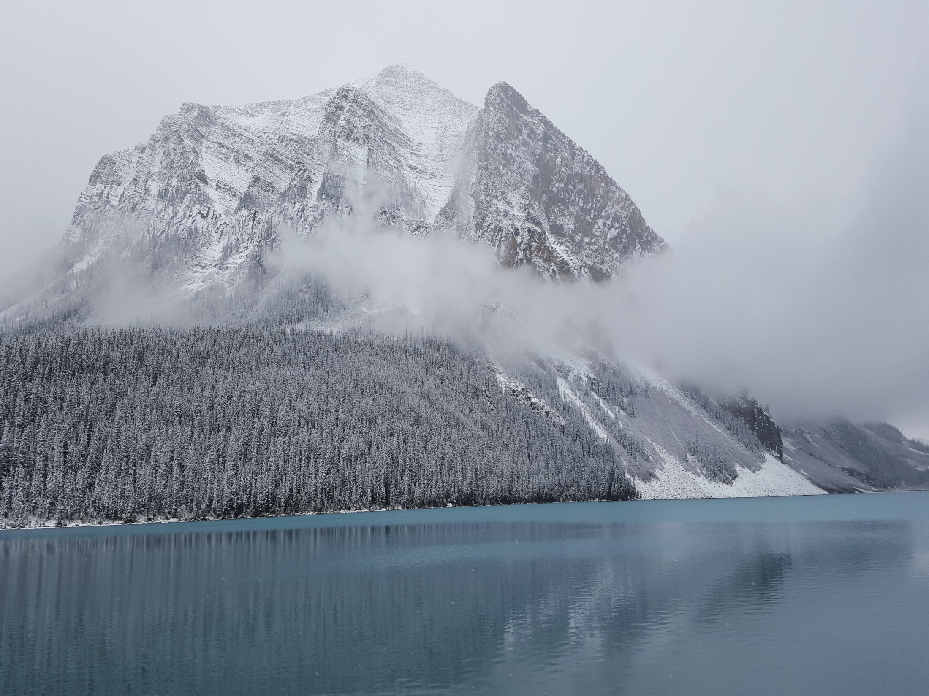


Elevating Language Learning to New Heights
Preposterous Prepositions: Practice with English
William Moore
william.moore@viu.ca

Slide 2

Preposterous Prepositions! Practice with English
The preposition
is conventionally thought of as the first word
of a prepositional phrase.
Gorrell & Laird. Modern English Handbook. 1958
A prepositional phrase
consists of a preposition and its object, which is nearly always a noun group.
Collins Cobuild. English Grammar. 1992
as words that
‘express a relationship of meaning between two parts of a sentence.’
David Crystal. The Cambridge Encyclopedia of the English Language (1995)

Slide 3
Preposterous Prepositions! Practice with English
50 Common Prepositions
about | at | during | off | to
above | before | for | on | toward
across | behind | from | onto | under
after | below | in | opposite | until
against | beneath | inside | out of | up
along | beside | into | in front of | through
alongside | between | like | over | with
among | beyond | near | past | within
around | by | next to | per | without
as | down | of | since | worth

Slide 4
Preposterous Prepositions! Practice with English
Bluenose put in a full fishing season in the spring and summer of 1921. This was a condition for entrance into the International Fisherman's Race against the Americans - which was the real reason for building the Bluenose. Captain Angus Walters had been fishing ever since he was 13 years old. He learned how to sail on his father's fishing schooner. When he became captain of the Bluenose, people said he was a difficult man to get along with, but he was very intelligent and knew how to handle his ship. He could bring her through any kind of water or poor weather conditions.
White, Joan. (1997). Listen to the Loon. Oxford. Toronto, Can.

Slide 5
Preposterous Prepositions! Practice with English
Bluenose put in a full fishing season in the spring and summer of 1921. This was a condition for entrance into the International Fisherman's Race against the Americans - which was the real reason for building the Bluenose. Captain Angus Walters had been fishing ever since he was 13 years old. He learned how to sail on his father's fishing schooner. When he became captain of the Bluenose, people said he was a difficult man to get along with, but he was very intelligent and knew how to handle his ship. He could bring her through any kind of water or poor weather conditions. 14 verbs

Slide 6
Preposterous Prepositions! Practice with English
Bluenose put in a full fishing season in the spring and summer of 1921. This was a condition for entrance into the International Fisherman's Race against the Americans - which was the real reason for building the Bluenose. Captain Angus Walters had been fishing ever since he was 13 years old. He learned how to sail on his father's fishing schooner. When he became captain of the Bluenose, people said he was a difficult man to get along with, but he was very intelligent and knew how to handle his ship. He could bring her through any kind of water or poor weather conditions. 12 preps

Slide 7
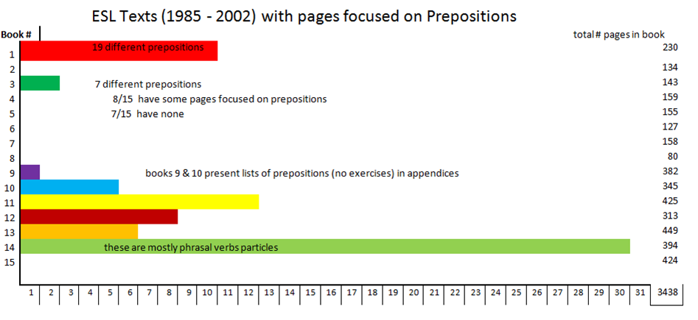
Preposterous Prepositions! Practice with English
Pages focused on prepositions
74 / 3438 = 2%

Slide 8
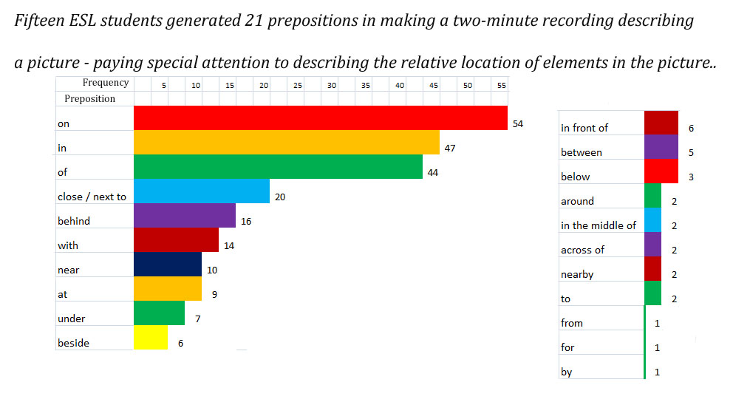
Preposterous Prepositions! Practice with English
15 Location prepositions
6 other prepositions

Slide 9
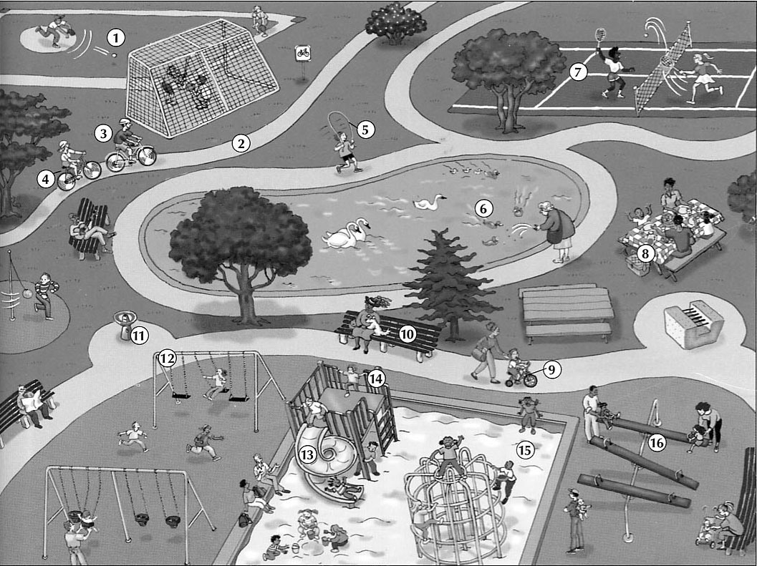
Preposterous Prepositions! Practice with English
Notes:
Look at this picture – find it in your handouts – pair up – one of you describe the picture with special attention to location relative to other objects in the picture, the other records the prepositions used – set a timer for 2 minutes.

Slide 10
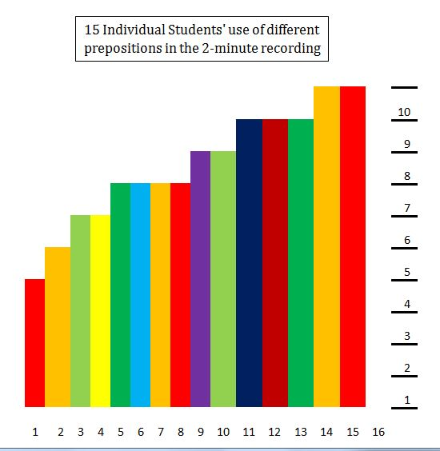
Preposterous Prepositions! Practice with English

Slide 11
Preposterous Prepositions! Practice with English
At a TEAL Annual Conference in Vancouver, BC, in 1998 Lee Gunderson & Catherine Eddy working with Immigration Canada, responsible for ESL Testing & classroom placement of 20,000 student per year announced that:
  “Advanced placement in Canadian High Schools
  is determined almost exclusively by the student’s ability to use prepositions correctly.”
Is this because prepositions are difficult to use, or because we do not teach their use very well?

Slide 12
Preposterous Prepositions! Practice with English
Stage 1 & 2 – Adverb & Adverbial Placement
Preposition
Word
Preposition
Function
Preposition
Phrase
Preposition
Phrase Type
three white _{v}
_{v} clear
on
L
the ducks on the pond
N - N
picnic_{v}
at
L
a family at the table
N - N
playground_{v}
under
L
a child under the structure
N - N
at
T
lunch at noon
N - N
with
A
a man with a guitar
N - N
two small _{v}
_{v} new
in at
L T
kids in the sandbox at recess
N – N - N

Slide 13
Preposterous Prepositions! Practice with English
The 4 functions prepositions perform:
Location / Place | Motion / Direction | Time | Abstract
on, off, over, under, below, beneath, beside, in, out, between, near… | into, out of, from, to, up among, toward through, forward… | at, in, on, by, to, from, until, since… | with, by, for, from, of…

Slide 14
Preposterous Prepositions! Practice with English
The 4 functions prepositions perform:
Location / Place | Motion / Direction | Time | Association
on, off, over, under, below, beneath, beside, in, out, between, near… | into, out of, from, to, up among, toward through, forward… | at, in, on, by, to, from, until, since… | with, by, for, from, of…
The different preposition phrase types:
Noun – Noun ; Verb – Noun ; Verb _{noun} – Noun ; Verb Noun – Noun ; Noun – Noun – Noun ; Verb – Verb
The Grammar that can be taught using preposition phrases
Prepositions - function, meaning, use · Adjectives – meaning, placement
Adverbs – meaning, placement · Verbs –transitive and intransitive structures
Direct objects – indirect objects · Simple sentence – formation · Appositives
Relative clauses – integration into simple sentences · dangling modifiers
Complex sentence formation · phrasal verbs · and loads of vocabulary

Slide 15
Preposterous Prepositions! Practice with English
Preposterous Prepositions is a system of teaching-learning English which uses the preposition as the focus of study – rather than the verb tenses.
STAGE 1 – introduce the ‘preposition’ as a type of word – practice location (L) prepositions
STAGE 2 – practice with abstract (A) and time (T) preposition phrases: develop table
STAGE 3 – introduces the motion (M)preposition phrases
STAGE 4 – study adverbs and adverbials; add to table
STAGE 5 – develop sentences from phrases; add appositives and relative clauses
STAGE 6 – study subordinate clauses and participle phrases
Notes:
Stages 1 & 2 introduce the preposition as a “type of word.” The four categories of prepositions are introduced, but only the first category (Locational) is practiced. Real ‘Beginners’ practice describing a picture using a variety of locational prepositions. ‘False beginners’ might practice identifying these words in a text, and then use these prepositions to describe things they see in a picture. The idea of a “preposition phrase” as a group of words in which two noun groups are linked by a preposition into a locational relationship is introduced and a table for recording these phrases is introduced. The simple N – N phrase is extended into multiple N – N – N phrases and the addition of adjectives is explored.

Slide 16
Preposterous Prepositions! Practice with English
Bluenose put in a full fishing season in the spring and summer of 1921. This was a condition for entrance into the International Fisherman's Race against the Americans - which was the real reason for building the Bluenose. Captain Angus Walters had been fishing ever since he was 13 years old. He learned how to sail on his father's fishing schooner. When he became captain of the Bluenose, people said he was a difficult man to get along with, but he was very intelligent and knew how to handle his ship. He could bring her through any kind of water or poor weather conditions. 12 preps

Slide 17
Preposterous Prepositions! Practice with English
Preposition
Word
Preposition
Function
Preposition
Phrase
Preposition
Phrase Type
full fishing_{v}
in
L
a season in the spring
N - N
picnic_{v}
of
A
summer of 1921
N - N
playground_{v}
for
A
a condition for entrance
N - N
_{v} International Fisherman’s
against
A
the race against the Americans
N - N

Slide 18
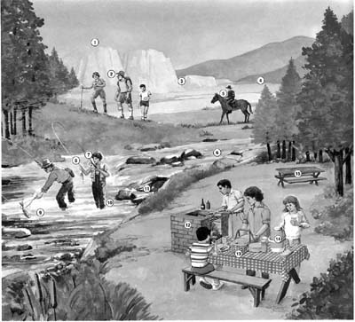
Preposterous Prepositions! Practice with English

Slide 19
Preposterous Prepositions! Practice with English
Stage 3 – Motion (M) Preposition Phrases
Preposition
Word
Preposition
Function
Preposition
Phrase
Preposition
Phrase Type
for
A
is fishing for trout
V - N
across
M
is riding across the valley
V - N
into
M
are walking into the forest
V - N
cautiously ^{Λ} Λ Λ
on
L
is sitting on his horse
V - N
comfortably Λ Λ
at
L
is catching a fish in his net
Vn - N

Slide 20
Preposterous Prepositions! Practice with English
dutifully.
I went home. yesterday.
How?
Where?
When?
mindfully.
I bought some cheese from the deli.
first.
How?
Where?
When?
What?
carefully.
I posted your letter in the mailbox.
after lunch.
How?
Where?
When?
sadly.
Then, I returned home.
at 1:30.
How?
Where?
When?

Slide 21
Preposterous Prepositions! Practice with English
"How" adverbs go closest to the verb, usually after it, but sometimes before it.
Ali jumped quickly over the lion, yesterday.
#1 “How” position
Ali quickly jumped over the lion, yesterday.
#2 “How” position
Ali jumped over the lion quickly, yesterday.
#3 “How” position
And for “special effect,”
they can go at the beginning or end of the sentence.
Quickly, Ali jumped over the lion, yesterday.
Ali jumped over the lion yesterday, quickly.
Ali jumped over the lion yesterday – quickly!

Slide 22
Preposterous Prepositions! Practice with English
"When" adverbs go at the beginning or end of the sentence.
Yesterday, Ali jumped quickly over the lion.
#1 “When” position
Ali jumped quickly over the lion, yesterday.
#1 “When” position
"Where" adverbs always go after the Verb Group (V + DO)
Ali jumped quickly over the lion.
Ali jumped over the lion quickly.
Skillfully, Ali kicked the ball into the net as the final whistle blew.
( V + DO )
Skillfully, Ali into the net kicked the ball as the final whistle blew.
Skillfully, Ali kicked into the net the ball as the final whistle blew.
Skillfully, Ali kicked the ball as the final whistle blew into the net .

Slide 23
Preposterous Prepositions! Practice with English
Are the following examples
Transitive (Vn), Intransitive (V) or Ergative (VN) structures?
T (Vn - N)
is catching some fish for dinner ___
are eating lunch with each other ___
is riding his horse through the valley ___
are sizzling under the burgers ___
is holding a drink in her hand ___
is cooling in the man’s hand ___
are staying in tents at the campground ___
are singing songs from “Titanic” ___
E (VN - N)
E (VN - N)
I (V - N)
T (Vn - N)
I (V - N)
E (VN – N - N)
T (Vn - N)

Slide 24
Preposterous Prepositions! Practice with English
Stage 5 – Combining Preposition Phrase types to form Simple Sentences
N – N V* - N
the horseman beyond the river is riding through the valley
the hamburgers on the grill are sizzling over the coals
the people around the campfire are talking about their climb
the table under the trees is sitting in the shade
the cup of juice feels cold in her hand
the hikers across the river are walking up the hill
the man in the river is catching a trout for lunch

Slide 25
Preposterous Prepositions! Practice with English
Stage 5 - Adding Appositives, Relative Clauses & Subordinate clauses
Mrs. Black, the lady by the pond, is feeding the ducks.
Mr. Jones, the horseman who is beyond the river, is riding through the valley today.
These new hamburgers, the ones on the grill, taste much better than the ones we used to buy.
Jack, John and Marty are the people around the campfire who are talking about their climb.
My son has a bike made by Raleigh, a company in Canada that went into bankruptcy recently.
The climbing structure in the playground, the half-dome of metal bars, is old and rusty.

Slide 26
Preposterous Prepositions! Practice with English
Preposition
Word
Preposition
Function
Preposition
Phrase
Preposition
Phrase Type
three white _{v}
_{v} clear
on
L
the ducks on the pond
N - N
two small _{v}
_{v} new
in at
L T
kids in the sandbox at recess
N – N - N
old _{v}
toward
M
are swimming toward the lady
V - N
swiftly ^{ʌ}
^{ʌ}
^{ʌ}
delicious _{v}
from
A
are eating the food from her hand
VN - N
eagerly ^{ʌ}
^{ʌ}
^{ʌ}
dark haired _{v}
on
ML
is pushing his daughter on the swing
Vn - N
^{ʌ} happily
^{ʌ}
^{ʌ}

Slide 27
Preposterous Prepositions! Practice with English
Stage 5 – Rare Phrases & Lookalikes
Preposition
Word
Preposition
Function
Preposition
Phrase
Preposition
Phrase Type
to
M
is flying to Paris
V - N
to
inf
likes to eat
right _{v}
up
phV
walked up to the clerk
phV - N
for
A
the reason for building
N - Vpart
by
A
is earning money by working
Vn - V

Slide 28

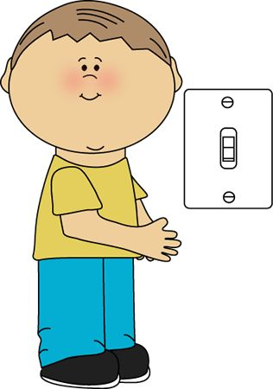


Preposterous Prepositions! Practice with English
Preposition vs Phrasal Verb Particle
Phrasal verb particle
Please, turn on the light.
Preposition
Smoke in the
hallway/ aisle
Please, crawl down there and turn on the light.
exit
no exit
exit

Slide 29
Preposterous Prepositions! Practice with English
A gorilla went shopping in Macy’s one day. He was in the umbrella department, on the first floor, opening and closing the umbrellas and throwing them on the floor. He seemed to be getting very angry.
A customer was watching all this and finally ran up to a clerk and said, “Excuse me, but there’s an angry gorilla over there playing with the umbrellas.”
“I’m sorry,” said the clerk, “but that’s not my department. Try the third floor.” So the customer ran to the third floor, found the manager, told him the story, and they both rushed back to the gorilla. The manager was trembling, but he tried to smile and walked right up to the big beast, saying, “Pardon me, Sir or Madam, but, well, you know we’ve never seen a gorilla in Macy’s before.”
“I’m not surprised,” said the gorilla, “and with these prices you’re not going to see many more either.”
From: Graham, C. (1982) The Electric Elephant. Oxford U. Press

Slide 30
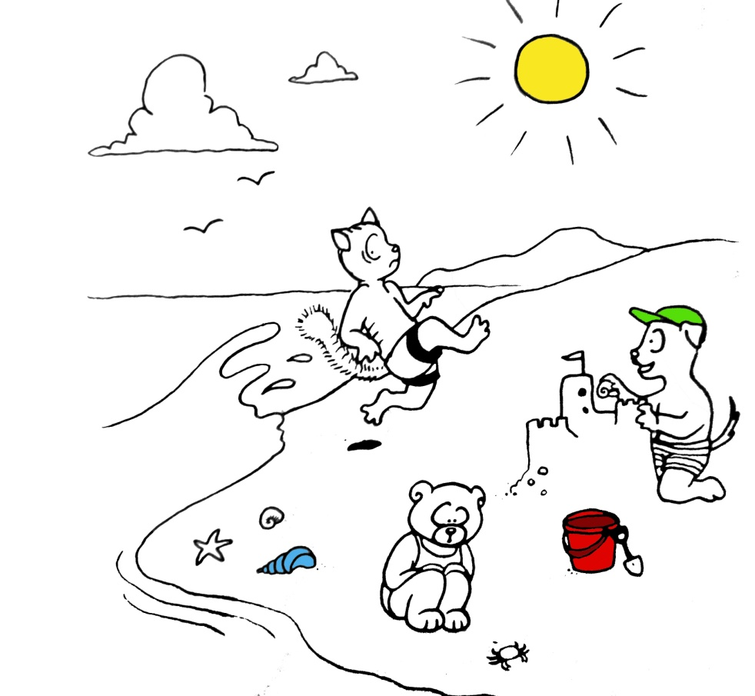
Preposterous Prepositions! Practice with English
A Day at the Beach
Three children from Nanaimo are playing at the beach today. Fred, the boy in the green hat, is building a castle out of sand – a sandcastle. Joe is playing in the waves. Right now he is running away from a wave. Jenny is watching a crab crawl up the beach. The children come to the beach every summer. They play by the water every day. Their mom even brings lunch to them so they don’t have to stop playing. Now that’s the life for me!
Jenny is watching a crab crawl up the beach.
Jenny is watching as a crab crawls up the beach.
Jenny is watching a crab as it crawls up the beach.

Slide 31
Preposterous Prepositions! Practice with English
A Simple English Lesson
proposes that
the preposition be taught as
‘the middle or linking word in a preposition phrase, connecting
nouns and verbs in relationships of Location, Motion, Time and other Abstract Associations’
Notes:
In keeping with David Crystal’s definition – which is a little too general

Slide 32
Preposterous Prepositions! Practice with English
And further, that lessons based on Preposterous Prepositions become integrated into the current curricula for English as a first, second (or any other number) language.
(2% is not enough!)

Slide 33
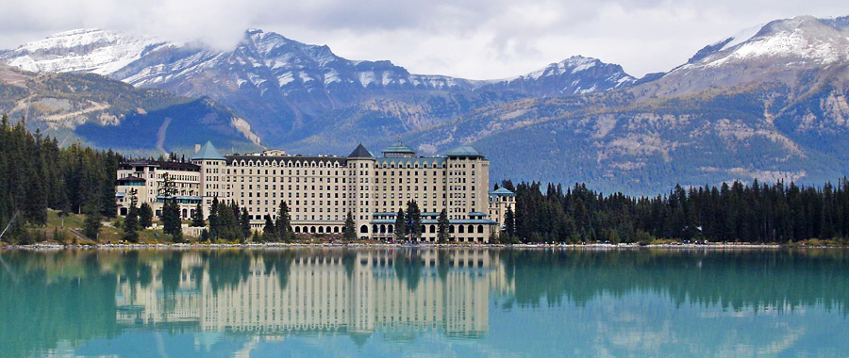
The End
Preposterous Prepositions: Practice with English
William Moore
william.moore@viu.ca

