Slide 1
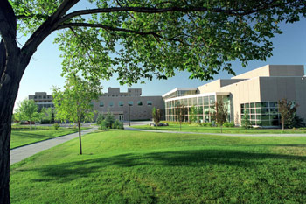

English Grammar Uncloaked
William Moore
Land of Living Languages
TESL CANADA CONFERENCE MAY 8 - 10, 2014 REGINA, SK

Slide 2

English Grammar Uncloaked
a
Grammar is made up of two major parts:
1) A set of agreements or conventions about how words will be organized.
a
W
What is ‘grammar’ ?
‘g
?
m
h
r
r'
2) a set of visible changes to words and word order that change the meaning of the ‘standard’ sentence/question.
t
a
i
I am.
I am not.
Am I ?
m
s

Slide 3

English Grammar Uncloaked
The only information about time and space in a book is put there by the author.
Speech happens in an information-rich environment.

Slide 4
English Grammar Uncloaked
Three Concepts Paramount to Understanding
“Grammar”, Writing, and Speech
elision –
“I am happy.” = “I am a happy person.”
That “I” = a “person” is obvious. This information can be elided.
underlying form vs surface form.
the second sentence above is in underlying form.
The first is in surface form.

Slide 5
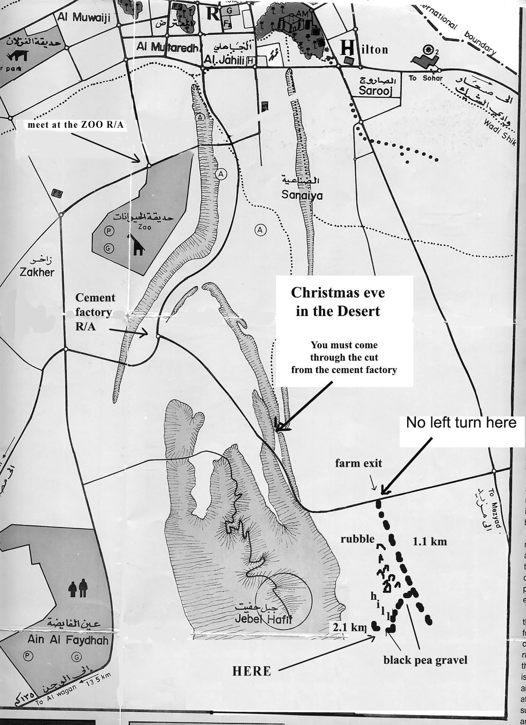
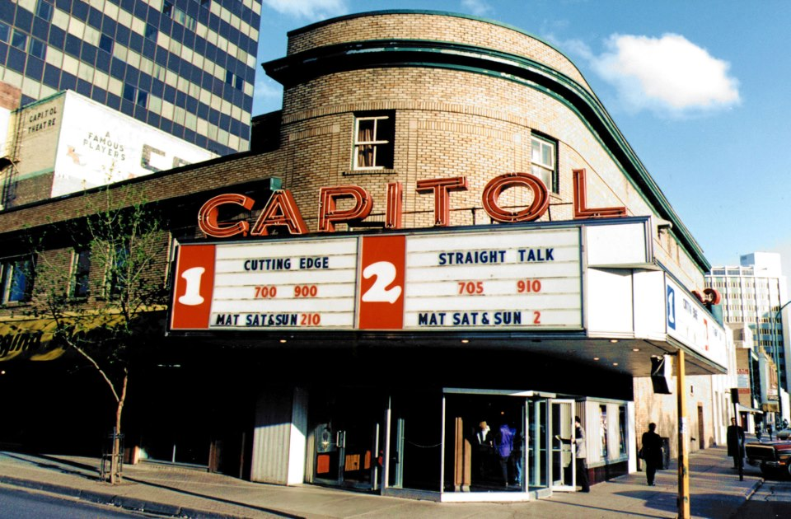
English Grammar Uncloaked
Strangers need detailed directions
Locals can use major landmarks

Slide 6

English Grammar Uncloaked
Tic toc tic toc tic toc…
Hey dad! – What’s a second?
Well son – it is a unit of time equal to the sixtieth part of a minute or degree.
Huh?
Well – it’s equal to the length of time it takes a beam of light travelling through a vacuum to go 186,300 miles.
Uh…thanks, dad!
What good is a definition that doesn’t make sense?

Slide 7


English Grammar Uncloaked
Hey mom – What’s a second?
Hold on a minute, Tommy – I’ll be with you in a second.
Uhh - I’m going out to play now, mom.
We often use language idiomatically!

Slide 8
English Grammar Uncloaked
The Best explanation is not always a definition!
Hey Fred – How long is a second?
Oh that’s easy, Tommy – If you count 1, 2, 3, 4… and say “elephant” after each number - that’s about how long each second is.
“1 elephant, 2 elephant, 3 elephant, 4 …aaaahhhhh – Why didn’t somebody just say so?

Slide 9

English Grammar Uncloaked
ASPECT as viewpoint
F ⬅
➔ P
‘TIME – as a line

Slide 10
English Grammar Uncloaked
F
BE – with a single “context” verb in the sentence
I am hungry.
true for a short time - until I eat
N
He is my father.
true while both my father and I are alive.
true for a very long time
The atmosphere is about 11 km thick.
P
When we use the BE verbs, ‘am, is, & are’ we are not concerned with the measurement of time – we simply acknowledge that both ‘time’ and ‘space’ exist. Together these form ‘CONTEXT.’

Slide 11
English Grammar Uncloaked
The “Ongoing” or Continuous Aspect
A duration of time is considered
Time is looked at from the side
The ‘Tense’ is shown by the ‘Primary’ verb
The ‘Aspect’ is indicated by the “ing” suffix
My horse is eating.
P
N
F
Past continuous
Present continuous
future continuous
My horse was eating.
My horse will be eating.

Slide 12
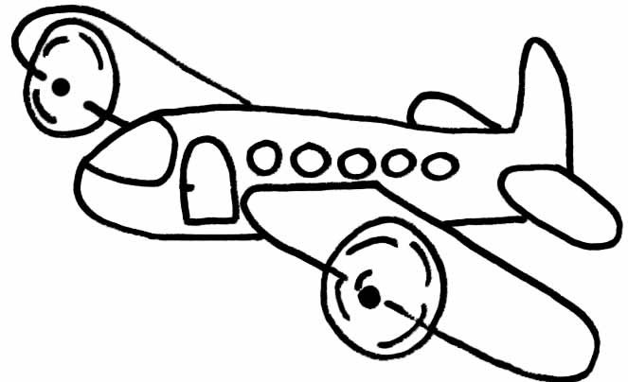
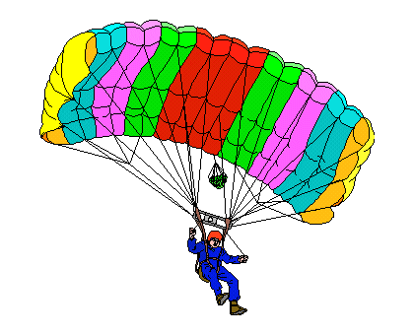
English Grammar Uncloaked

Slide 13
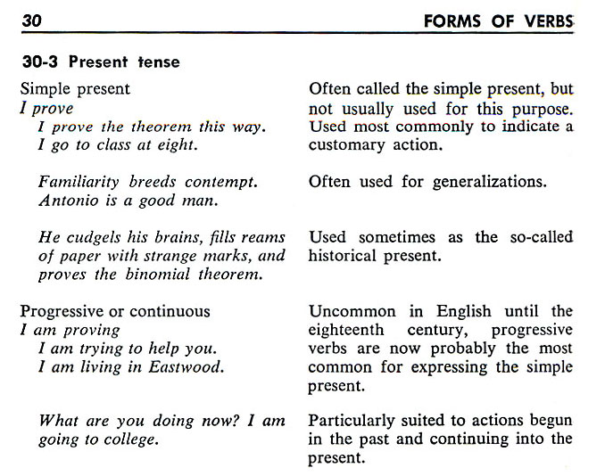
English Grammar Uncloaked
Gorrell and Laird. (1956). Modern English Handbook. Prentice-Hall. Englewood Cliffs, N.J.

Slide 14
English Grammar Uncloaked
300 odd years ago
250 not so odd years ago
I cook steak now.
I am cooking steak now.
The Simple Present Tense
The Present Progressive Tense

Slide 15
English Grammar Uncloaked
The Current Explanation of the English Verb System
ASPECT ↓
Simple
Continuous
Perfect
Perfect Continuous
TIME ⇒ | Past | Present | Future
Simple Past | Simple Present | Simple Future
Past Continuous | Present Continuous | Future Continuous
Past Perfect | Present Perfect | Future Perfect
Past Perfect Continuous | Present Perfect Continuous | Future Perfect Continuous
Simple
Present

Slide 16
English Grammar Uncloaked
SUBJECTS : Proper Nouns, Common Nouns, & Pronouns
Singular
English
Arabic
3rd Person
1st
Person
I
You
He
She
It
Alfred
The teacher
We
You
They
Art and Alfred
The teachers
هو
هي
هم
هن
أنت
أنتي
أنتم
أنتن
أنا
نحنِ
he
she
they
they
you
you
you
you
I
we
Singular
(masc)
2nd
(fem)
Plural
(masc)
(fem)
3rd
2nd Person
Singular
(masc)
Plural
(fem)
Plural
1st
Person
(masc)
2nd
(fem)
1st Person
Singular
3rd
Plural
Notes:
By convention, English Subjects are organized this way – by simple agreement – Arabic Subjects – by way of contrast are organised quite differently.

Slide 17
English Grammar Uncloaked
A Simple Way of Organizing English Verbs
BE
DO
HAVE
Verb Families
Verb Families
P R I M A R Y V E R B S
am
is
are
was
were
do
does
do
did
did
have
has
have
had
had
← 100 + Irregular verbs
1000s of Regular verbs →
S E C O N D A R Y V E R B S
 | IRREGULAR VERBS
Past | ate | put | came
Root | eat | put | come
Past Part. | eaten | put | come
REGULAR VERBS
walked | played | stopped | laughed
walk | play | stop | laugh
walked | played | stopped | laughed
 | IRREGULAR VERBS
Past | ate | put | came
Root | eat | put | come
ongoing | eating | putting | coming
Past Part. | eaten | put | come
REGULAR VERBS
walked | played | stopped | laughed
walk | play | stop | laugh
walking | playing | stopping | laughing
walked | played | stopped | laughed
be | do | have
been | done | had
be | do | have
being | doing | having
been | done | had

Slide 18
English Grammar Uncloaked
Positive, Negative, Question
BE
I am a teacher. → I am not a teacher. → Am I a teacher?
He is a teacher → He is not a teacher. → Is he a teacher?
He was a teacher. → He was not a teacher. → Was he a teacher?
DO
I work at HCT. → I do not work at HCT. → Do I work at HCT?
He works at HCT. → He does not work at HCT → Does he work at HCT?
He worked at HCT. → He did not work at HCT. → Did he work at HCT?
HAVE
I have worked at HCT. → I have not worked at HCT. → Have I worked at HCT?
He has worked at HCT. → He has not worked at HCT → Has he worked at HCT?
He had worked at HCT. → He had not worked at HCT. → Had he worked at HCT?

Slide 19
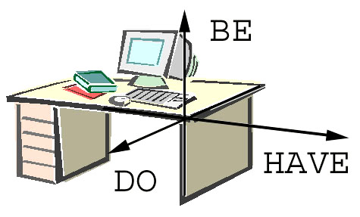
English Grammar Uncloaked
The Three Dimensions of English

Slide 20
English Grammar Uncloaked
The Grammar of DO
Subject
Primary verb
Secondary Verb
I
You
He
She
It
Arthur
The teacher
We
You
They
Ali and Sally
The teachers
do
do
does
does
does
does
does
do
do
do
do
do
play.
come.
work.
dance.
go.
fly.
think.
run.
jump.
have
want.
talk.
play.
come.
works.
dances.
goes.
flies.
thinks.
run.
jump.
have
want.
talk.
s
s
s
s
s

Slide 21
English Grammar Uncloaked
The Grammar of DO - Past
Subject
Primary verb
Secondary Verb
I
You
He
She
It
Ahmed
The teacher
We
You
They
Ali and Ahmed
The teachers
did
did
did
did
did
did
did
did
did
did
did
did
ed
ed
ed
ed
ed
ed
ed
ed
ed
ed
ed
ed
play.
come.
work.
dance.
go.
fly.
think.
run.
jump.
have
want.
talk.
played.
came.
worked.
danced.
went.
flew.
thought.
ran.
jumped.
had
wanted.
talked.

Slide 22
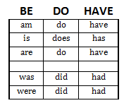
English Grammar Uncloaked
Contrary to popular belief – TIME in English grammar is not grammatically divided into past, present and future through a single system.
But these PRIMARY VERBS
refer to the PRESENT
by CONVENTION.
They can also refer to the FUTURE
These PRIMARY VERBS
refer to the PAST

Slide 23
English Grammar Uncloaked
Conditionals with BE and HAVE
Subjects
Conditionals
HAVE
Completion
BE
I
You
He
She
It
Arthur
The teacher
We
You
They
Ali and Sally
The teachers
been careful.
worked harder.
gone to Paris.
been working
played golf.
been a teacher.
done my duty.
worked here before.
a teacher.
happy.
in Paris.
working
worked to death.
strict.
on it.
with Patrick
shall
should
will
would
can
could
may
must
might
am
is
are
have
has
be
have

Slide 24
English Grammar Uncloaked
Conditionals with DO
Subjects
Conditionals
I
You
He
She
It
Ahmed
The teacher
We
You
They
Ali and Ahmed
The teachers
DO
Completion
shall
should
will
would
can
could
may
must
might
do
does
my job.
the cooking.
his homework.
work at FMC.
works quickly.
play the violin.
plays football.
work at FMC.
work quickly.
play the violin.
play football.
do

Slide 25
English Grammar Uncloaked
Regular Secondary Verbs
When BE Primary verbs precede a regular secondary verb, the secondary verb can only be in one of two forms:
1) (__ing) form - indicates that the subject is the actor – the direction of processing these words is from left to right.
Ex: He was remembering his friends.
2) (__ed) form – indicates that the subject is the receiver of the action - the direction of processing these words is from right to left.
Ex: He was remembered by his friends.

Slide 26
English Grammar Uncloaked
The ‘__ed’ Suffix
‘__ed’ is currently called the ‘Past Tense’ marker. While it does indeed indicate the past tense in sentences in the DO Dimension.
Ex: “She did want a job,”
Ex: “She did wanted a job,”
It does not always mark the past tense, as can be seen in:
“He is wanted for murder.”
which is a statement in the BE dimension.
Could there be a single explanation for these two different situations?

Slide 27
English Grammar Uncloaked
The Reflective Suffix ‘__ed’
The ‘__ed” suffix in DO Dimension statements such as,
I did work. =
I worked.
causes a reversal in the direction of time.
But the ‘__ed” suffix in BE Dimension statements such as,
I am wanted.
causes a reversal in the direction of action.
The ‘ed’ suffix reflects ‘Time’ backwards in the DO Dimension, and
the ‘Direction of Action’ backwards in the BE Dimension.
The “__ed” suffix has a reflective property
specific to the dimension it occurs in.

Slide 28
English Grammar Uncloaked
Ongoing and Reflective Suffixes in Adjectives
Also, consider the noun groups:
a wanted man the action is happening to the man
a dancing man the man is doing the action
a bored man the action is happening to the man
a boring man the man is doing the action
an interested man the action is happening to the man
an interesting man the man is doing the action
an excited man the action is happening to the man
an exciting man the man is doing the action

Slide 29
English Grammar Uncloaked
Reflective Form
Again we see that the ‘ed’ suffix causes a reversal of direction in the application of the action implied by the adjective form of the word.
This is a re-affirmation of its ‘Reflective’ characteristic.
One simple explanation instead of three or four different ones.
The ‘ed’ suffix is reflective in nature.
It causes a reversal in direction :
1) to ‘Time’ in the DO Dimension;
2) to the ‘Direction of Action’ in the BE Dimension;
and 3) to the ‘Direction of Application’ as an adjective.

Slide 30
English Grammar Uncloaked
English has 3 Dimensions: BE, DO, & HAVE;
  BE invokes ‘Context’
  DO invokes ‘Action’
  BE + DO = Action in Context
  HAVE invokes ‘Relationships through Time’
The Primary verbs indicate two ‘Tenses:’ ‘Past’ & ‘Not Past’
All Positives, Negatives & Questions are formed with Primary verbs
The DO Primary verbs are elided in the Positive case
  with ‘s’ or ‘es’ suffixed onto the 2ndary verb in the ‘Not Past’ Tense
  with ‘ed’ suffixed onto the 2ndary verb in the ‘Past’ Tense
The ‘__ing’ suffix indicates an ‘Ongoing’ or left-to-right application
The ‘__ed’ suffix indicates a Reflective’ or right-to-left application, such that:
  after a DO primary verb ‘Time’ is reflected ;
  after a BE Primary verb ‘Direction of Action’ is reflected

Slide 31
Fin
English Grammar Uncloaked
William Moore
Land of Living Languages
TESL CANADA CONFERENCE MAY 8 - 10, 2014 REGINA, SK

