Slide 1




A Simple English Lesson
On
How to Use
“Never Get Lost”
Readings
Will J. Moore, M.Ed., TESL Dipl.
dreigo.will@gmail.com
Notes:
Introduce yourself – began in ’93
The Simple Present Tense Does Not Exist
Preposterous Prepositions
CALL in teaching
Adverbs
Possessive adjectives !!!
What is an adjective? –
A word preceding a noun that describes some innate characteristic of that noun.
According to some people any word that precedes a noun – “the”
And so we come to “Me, My & I”
“bayti – baytak – baythu”

Slide 2
How to Use “Never Get Lost” Readings
1. They combine books and television
What are
“Never Get Lost”
Readings?
2. They provide: left – right eye guidance
synchronized voice & text
large fonts and open line spacing
This means that students can:
easily focus on the story
& never get lost

Slide 3
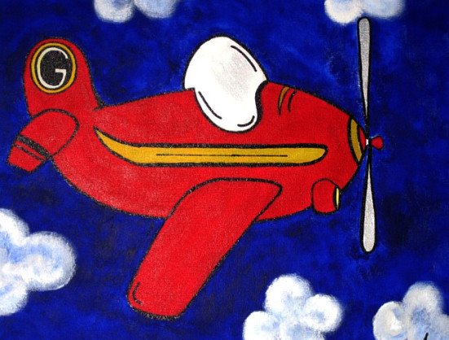
A Fishing Trip
We were standing on the bridge, trying to catch some fish for supper when a small red plane flew almost directly above our heads. We could even see the pilot's face. "What on earth is he up to?" I asked. I felt rather annoyed.
"I think he's in trouble," Jack said. "His engine is making a strange noise."
"Well, we can't do anything, can we?" I said. "We can't even phone from here." We were on a boating holiday and we were miles from the nearest town.
Byrne, D. Basic comprehension Passages. Longman; London, UK.

Slide 4
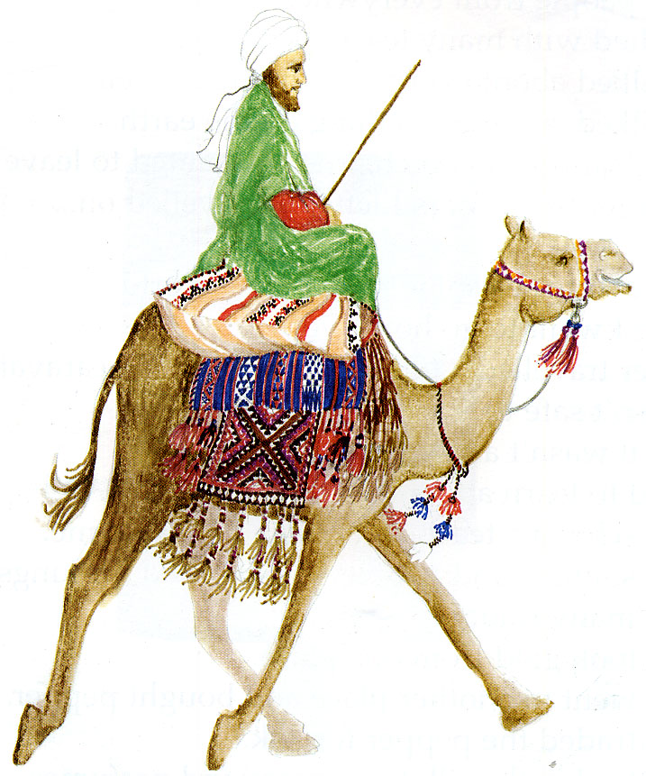
He gave me some cakes.
He gave me some money.
And he sent me on my way.
I got a camel to cross the desert.
I met some other travellers.
We made a caravan.
A caravan is many people travelling together.
Some camels carried our books and clothes and food and water and blankets and gifts and…
Other camels carried us.
I was very happy.
I always wanted to travel.
I wanted to see the world!
.
From “The Amazing Adventures of Ibn Battutta” by Noura Durkee

Slide 5
Ch 01 There Was, There Was Not...
"I'm leaving," he said. "Now. The wind is blowing enough sand to cover my tracks."
Halima took his hands, feeling the bones, counting them. She touched his knuckles to her forehead.
"Go, then," she said, throwing his hands from her. "May Allah smooth your path homeward."
As if her words were magic, he rose and disappeared.
Halima sat alone, listening to the moan of the wind. She watched to see Atiyah ride off but saw only the skittish moon shadows of blown sand, moving like ghosts across the dunes, all flowing away from her. Tears stung her nose and eyes. She sat until the tears dried on her cheeks. She wiped her nose on the back of her hand, crawled into the tent, and slept.
From “Beduin’s Gazelle” by Francis Temple

Slide 6
How to Use “Never Get Lost” Readings
Pull the students back in to class after break
How can we use
“Never Get Lost”
Readings?
Practice in the classroom:
a) Group reading
b) Individual reading
c) vocabulary discussion
d) pronunciation practice
e) phrasing
f) projection

Slide 7
How to Use “Never Get Lost” Readings
Evaluation in the classroom:
a) Timeliness
b) Participation
c) Projection
d) Specific readings
e) Pronunciation correction
Assessment in the classroom:
a) Participation
b) Projection
c) Specific readings
d) Pronunciation

Slide 8
How to Use “Never Get Lost” Readings
Practice in the Lab:
a) Individual reading
b) vocabulary check
c) pronunciation practice
Evaluation in the Lab:
a) recordings done?
b) pronunciation correct?
c) intonation & phrasing
d) peer
e) production

Slide 9
How to Use “Never Get Lost” Readings
What do I need, to use
“Never Get Lost”
Readings,
and keep records of performance?
Assessment in the Lab: - overview of
a) recordings done
b) pronunciation correction
c) intonation & phrasing
e) production
f) variety

Slide 10
How to Use “Never Get Lost” Readings
Daily Charts of students / activities being evaluated
A simple range scale + comments spot
A filing system that tracks student, activity, & date

Slide 11
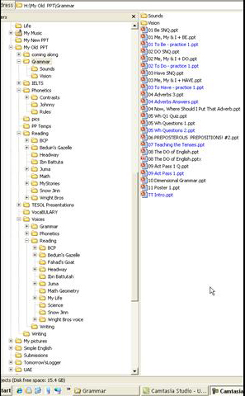
How to Use “Never Get Lost” Readings

Slide 12


A Simple English Lesson
On
How to Create
“Never Get Lost”
Readings
Will J. Moore, M.Ed., TESL Dipl.
dreigo.will@gmail.com
Notes:
Introduce yourself – began in ’93
The Simple Present Tense Does Not Exist
Preposterous Prepositions
CALL in teaching
Adverbs
Possessive adjectives !!!
What is an adjective? –
A word preceding a noun that describes some innate characteristic of that noun.
According to some people any word that precedes a noun – “the”
And so we come to “Me, My & I”
“bayti – baytak – baythu”

Slide 13
How to Create “Never Get Lost” Readings
Provides left to right reading guidance
Synchronized audio-visual input means a student can walk into the classroom, sit down, and join in immediately, because the words they are hearing are also appearing.
Distractions do not cause total failure, they merely distract.
Presentation of a limited amount of text allows for close examination of that text.
Computer presentation allows for replay
Students can learn to create their own NGL readings
Utilizes “modern” technology without stretching the limits

Slide 14
Never Get Lost Reading
Open PowerPoint – Delete auto-text boxes –insert a text box at the top of the page.
Put a title in it. Double click on the border. On the top menu tab, Click on Animations and then on Custom Animations. Click on “Add Effect, and select Entrance/ Fade – then set to “after previous “at “medium” speed.
Insert a second text box right across the page – add text by typing, or from copy pasting a separate document.
Return to Home tab, double click on text-box border to make solid line, and select font and size for your text.
Go to the Custom Animation task window, click Add Effect, select Entrance / Fade
Click on this slide in the clipboard on the left and Copy & paste 6 blank slides ahead.
Now click on your “text” textbox to outline it then in the Custom Animation Task Pane – click on the “v” on the right of it and select Effect Options, opening an “Effect” window.
In the “Fade” window, click on “Animate Text” and select “by word.”
Notice that a new field opens below that allows you to alter the speed at which the text appears – the higher the “delay” number, the slower the speed
Set it to [10, 20, 30] - Click OK - Click “play” icon to test.

Slide 15
Never Get Lost Reading
It is time to make your recording – click on “Slide show” select “Record Narration.”
In the record narration window click on “Change Quality” and in the “Sound Selection” window, click on the “Attributes” “v” – select 31 kb/sec (8 bit stereo)
Click ok (you only need to do this once each time you open PowerPoint – it remembers this factor throughout your recording session.
Click on “set microphone level” move the pointer to the middle - Click ok
Click in the box that says “Link” then click on “Browse” –navigate to the folder you want to store your sound file in and click “select.”
Now click on “ok” in the “Record Narration” Window - Read the words aloud phrase by phrase as they appear, until you reach the end of the page. Press the “Esc” key on your keyboard to stop recording.
A window opens that asks if you want to save your settings or not – choose “No.”
Now in the presentation editing window (the one you build the PPT in) – find the small yellow icon in the lower right corner of your page and delete it.

Slide 16
Never Get Lost Reading
Now click on your Title box, go to the Effect in the Task Pane and click on its “v” so you can scroll down to “Effect Options” and click on it.
Go to the “sound” field in the Fade window and scroll down to the last option “Other.” – click and navigate to your sound file – select it and it becomes attached to your text box.
Click on the “View Page” Icon in the lower status bar.
The sound file should be synchronized with the fade-in effect of the text.
Save your Never Get Lost Reading.

Slide 17
Never Get Lost Reading
Tricks:
Attach your sound file to the text box ahead of your words.
Use “with previous” and “after previous” for minor timing changes.
If you need to add empty space to your sound file, use Windows ‘Sound Recorder” [Start/All Programs/Accessories/Entertainment/ SR ] record a second of silence then insert your sound file (under Edit)
Use Font and Font Size together with Line Spacing to position your text on the page such that any sentence breaks are nicely positioned at the end of a line.
Also user Text Box width for this.
Place pictures in text boxes for ease of location.
KISS
Overlay text boxes with empty space in them to change speed on a page
(see BG CH 1 p.3)
Don’t try to do it all at once. Stage it.
When playing your PPT on any computer other than the creation computer, play it through twice so that the “new” computer gets the hang of it.
for pages that don’t synchronize well (PPT 2007), left arrow key takes you back, right arrow key restarts the page – seems to be a VERY Frequent occurrence.
To avoid copyright infringement, don’t replace the books, supplement them.

Slide 18
Never Get Lost Reading
Examples of Student work
Over a period of a few weeks, students were first shown a series of pictures and asked to talk about them for oral conversation, vocabulary building and sentence creation practice.
Then they were each tasked with creating a story about one particular picture – all different. When their stories had been peer and teacher edited, and each student had recorded their story, I put their stories into NGL PowerPoints. Here are some results.

Slide 19

I see a man looking at the sea. He is wearing a robe. He is standing on the beach. The color of the water is blue. It is very beautiful. The sand is yellow and soft. There are small villas on the hill.

Slide 20
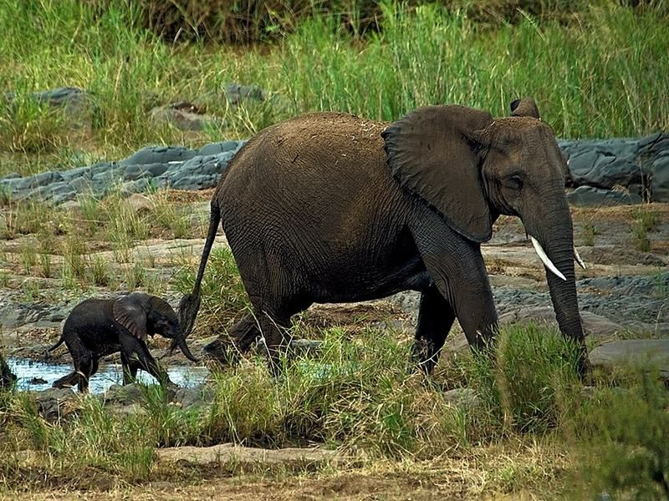
The picture is about a jungle and elephants. There are two elephants eating from the trees. There are two elephants, one big and one small. The water is a little hot. The trees’ color is brown.

Slide 21
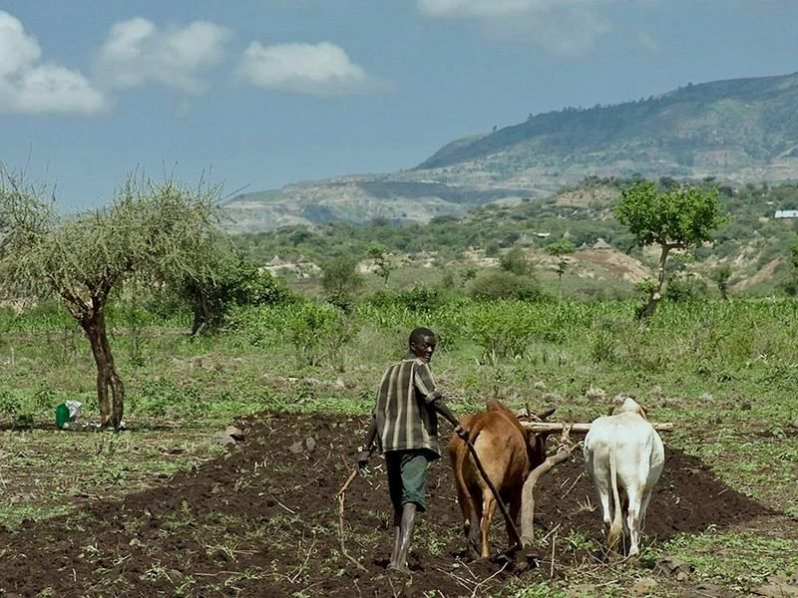
In the picture I see a man with two oxes. He is a farmer. His name is Saeed. He uses oxes for his farm to plough. After that he plants seeds in the ground. I see green trees and mountains at the back of his farm. The mountains are black color.

Slide 22
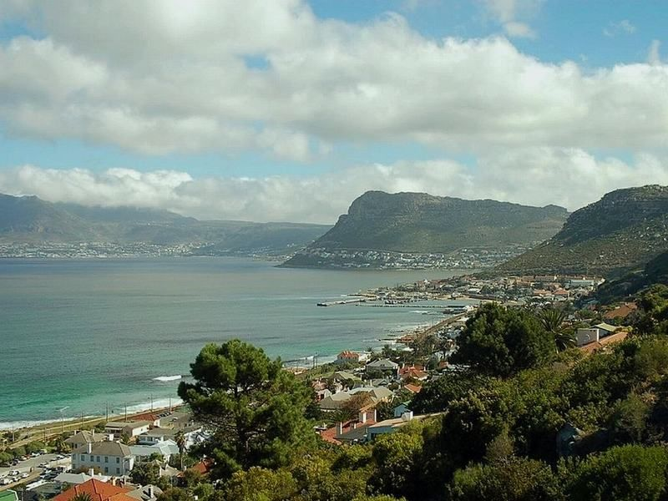
In my picture I see a beautiful sea. There are many hills. At the bottom of the hill there is a sea, and near the city there are green trees.
The End

