Slide 1



English Grammar: Behind the Screen
by William Moore
Sept. 30, 2016
Teaching in Techno­colours: Imagine, Innovate, Inspire
2016 BC TEAL Interior Regional Conference

Slide 2

Notes:
I grew up 3 miles away from the fishing village of Winter Harbour.

Slide 3

Notes:
The logging camp in 1967ish Family homes along the water, working men’s quarters back of them; my school boat down the dock.

Slide 4
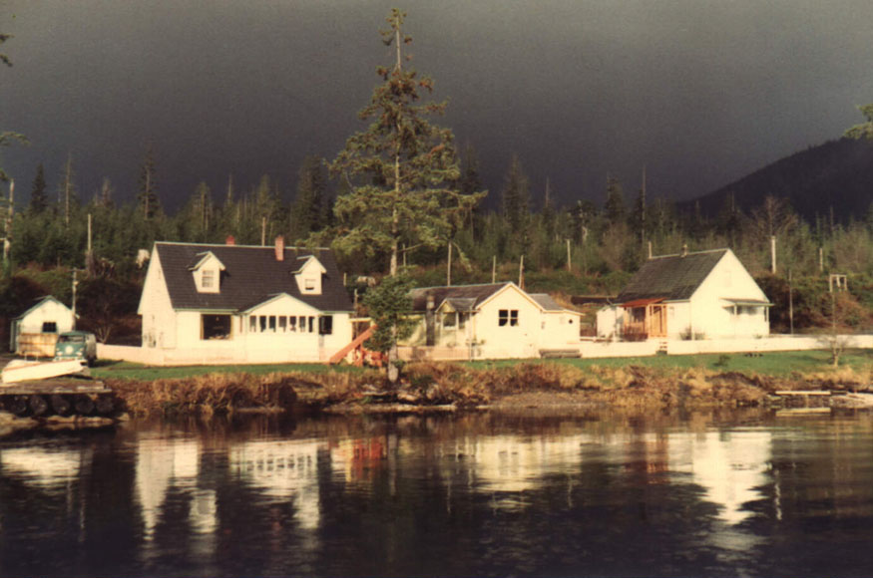
Notes:
My house on the left

Slide 5
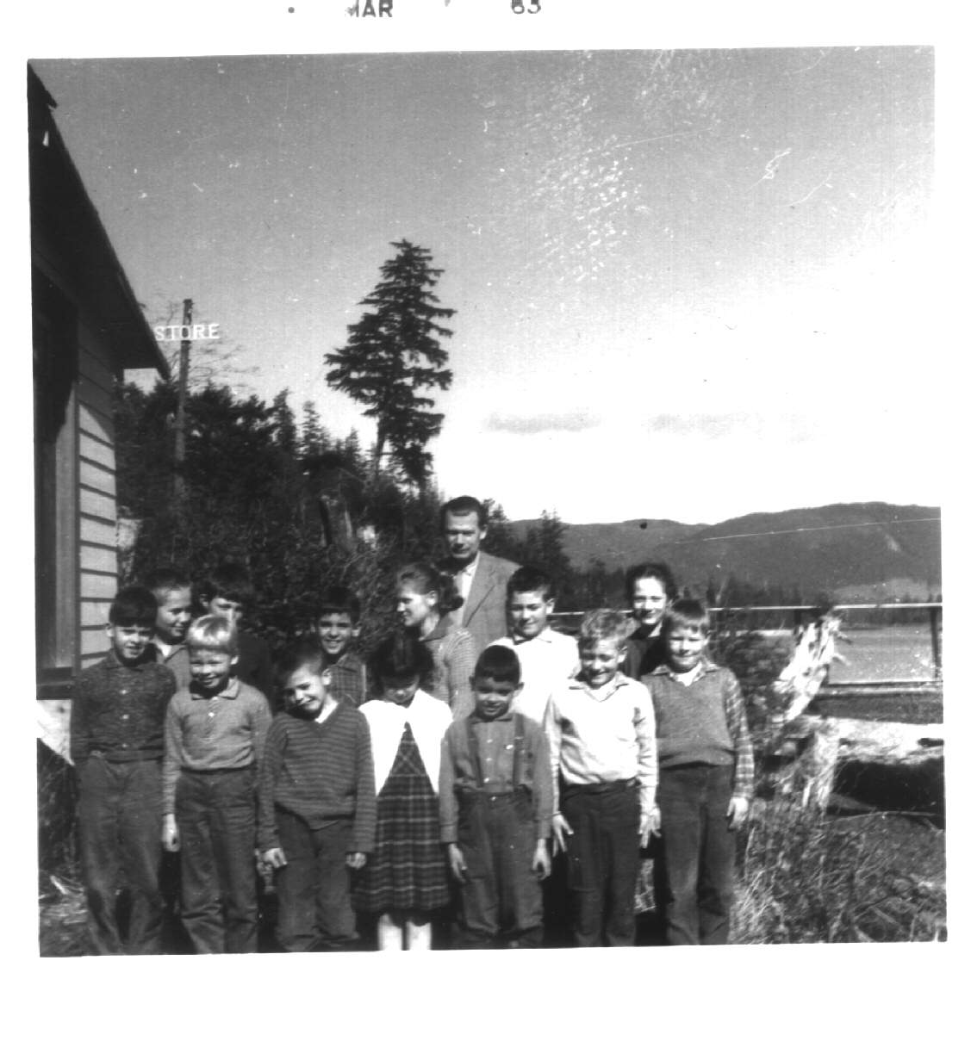
Notes:
A one-room, one teacher, all graders elementary school

Slide 6

Notes:
I hope to help you to see English grammar in a new way

Slide 7

Notes:
repeat

Slide 8


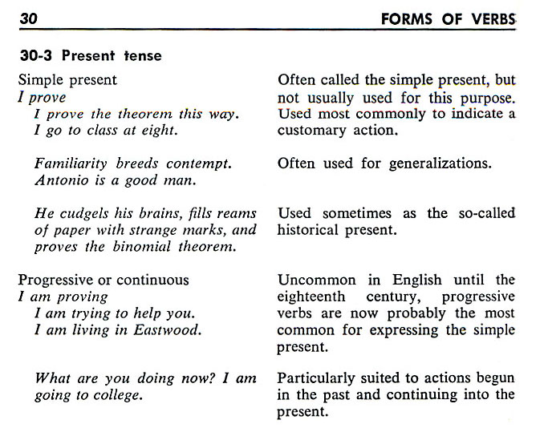

English Grammar: Behind the Screen
Notes:
Behind the screen.
If the simple present tense is not often used for this purpose, and the present progressive is usually used to express [what used to be expressed by] the simple present, why are we still referring to that verb form by that name? A ‘shell’ company serves the same purpose – to hide the truth.

Slide 9
English Grammar: Behind the Screen
SUBJECTS : Proper Nouns, Common Nouns, & Pronouns
Singular
English
Arabic
3rd Person
1st
Person
I
You
He
She
It
Alfred
The teacher
We
You
They
Art and Alfred
The teachers
هو
هي
هم
هن
أنت
أنتي
أنتم
أنتن
أنا
نحنِ
he
she
they
they
you
you
you
you
I
we
Singular
(masc)
2nd
(fem)
Plural
(masc)
(fem)
3rd
2nd Person
Singular
(masc)
Plural
(fem)
Plural
1st
Person
(masc)
2nd
(fem)
1st Person
Singular
3rd
Plural
Notes:
By convention, English Subjects are organized this way – by simple agreement – Arabic Subjects – by way of contrast are organized quite differently. By studying Arabic grammar (slightly) I was able to look at English with fresh eyes

Slide 10
do
do
does
does
does
does
does
do
do
do
do
do
English Grammar: Behind the Screen
I
You
He
She
It
Ahmed
The teacher
We
You
They
Ali and Ahmed
The teachers
do
do
does
does
does
does
does
do
do
do
do
do
do
do
does
does
does
does
does
do
do
do
do
do
not
not
not
not
not
not
not
not
not
not
not
not
work
study
talk
ride
go
fly
teach
sit
buy
want
have
mark
work
study
talks
rides
goes
flies
teaches
sit
buy
want
have
mark
We elide the DO primary verb in the positive, but suffix the ‘s’ or ‘es’ onto the 2^{ndary} verb in the 3rd person singular.
s
s
es
es
es
We retain the DO primary verb in the negative.
Notes:
Why do verbs in the 3rd person singular have an ‘s’ or ‘es’ added to them? This is why. We elide the primary DO verb in the positive because it is unnecessary to the communication, but we retain it in the negative and question.

Slide 11
English Grammar: Behind the Screen
Do
Do
Does
Does
Does
Does
Does
Do
Do
Do
Do
Do
I
You
He
She
It
Ahmed
The teacher
We
You
They
Ali and Ahmed
The teachers
I
you
he
she
it
Ahmed
the teacher
we
you
they
Ali and Ahmed
the teachers
do
do
does
does
does
does
does
do
do
do
do
do
work
study
talk
ride
go
fly
teach
sit
buy
want
have
mark
?
?
?
?
?
?
?
?
?
?
?
?
We also retain the DO primary verb in the question form.

Slide 12
English Grammar: Behind the Screen
I
You
He
She
It
Ahmed
The teacher
We
You
They
Ali and Ahmed
The teachers
did
did
did
did
did
did
did
did
did
did
did
did
id
id
id
id
id
not
not
not
not
not
not
not
not
not
not
not
not
work.
study.
talk.
ride.
go.
fly.
teach.
sit.
buy.
want.
have.
mark.
worked.
studied.
talked.
rode.
went.
flew.
taught.
sat.
bought.
wanted.
had.
marked.
Notes:
Here is a second example of eliding the DO primary verb and suffixing a part of it (the last sound) onto the following verb.

Slide 13
English Grammar: Behind the Screen
The lunar module was on the Moon. Astronaut Neil Armstrong had come out of the door and looked up into black space. He looked down at the gray rocks. The Moon waited. Slowly, he moved down the stairs. When he got to the bottom, he stopped. Then, he carefully put his foot down on the ground. He was the first man on the Moon.
Three hundred and twenty thousand kilometers away on Earth, people watched Neil Armstrong on television. They laughed and shouted. A man was on the Moon!
Jim Lovell sat in front of his television with his wife and children. "I'm not the first man on the Moon," Jim said to his son Jeffrey. "But I will go there."
Jeffrey was only five years old and he was excited. "Look at the rocks, Dad!" he shouted. "Look at the moon rocks!"
The lunar module was on the Moon. Astronaut Neil Armstrong had come out of the door and looked up into black space. He looked down at the gray rocks. The Moon waited. Slowly, he moved down the stairs. When he got to the bottom, he stopped. Then, he carefully put his foot down on the ground. He was the first man on the Moon.
Three hundred and twenty thousand kilometers away on Earth, people watched Neil Armstrong on television. They laughed and shouted. A man was on the Moon!
Jim Lovell sat in front of his television with his wife and children. "I'm not the first man on the Moon," Jim said to his son Jeffrey. "But I will go there."
Jeffrey was only five years old and he was excited. "Look at the rocks, Dad!" he shouted. "Look at the moon rocks!“¹
Notes:
If you really look at texts, with the knowledge that the DO primary verb is elided in the positive, you will see that every sentence in English falls within one of these 3 Dimensions of communication.

Slide 14
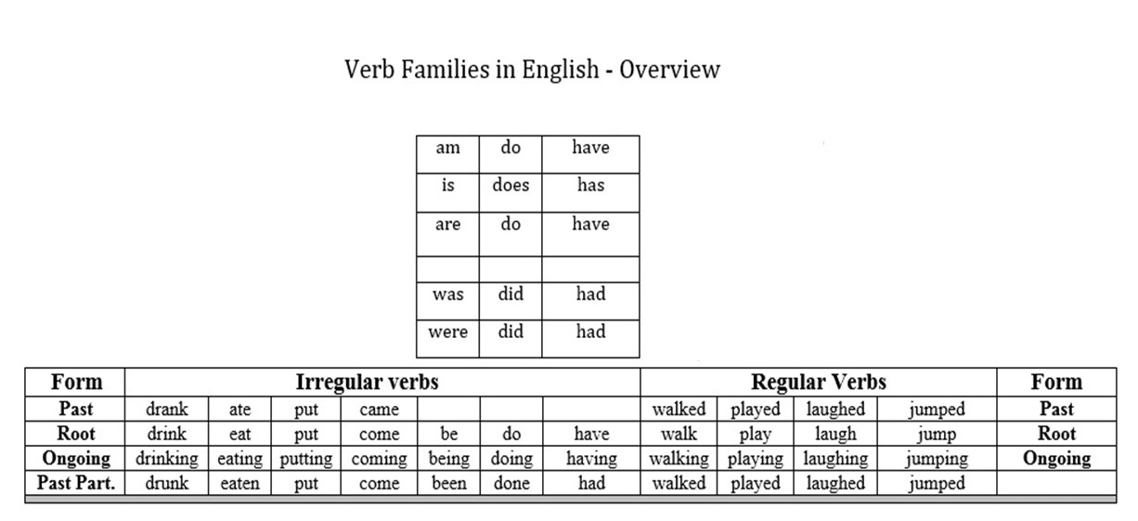
English Grammar: Behind the Screen
Notes:
Here is how we should be presenting English verbs to students [both L1 & 2, 3, 4, 5…] According to Lieberman, Erez, Jean-Baptiste Michel, Joe Jackson, Tina Tang, and Martin A. Nowak (2007) “The half-life of an irregular verb scales as the square root of its usage frequency: a verb that is 100 times less frequent regularizes 10 times as fast.”

Slide 15

English Grammar: Behind the Screen
Imagine
BE
DO
HAVE
“All simple English sentences”
The ‘Verb Families’, BE, DO & HAVE mark communication Dimensions
Notes:
These primary verbs actually predict the type of communication coming: single snapshot, a contiguous strip about a single ‘event’, a non-contiguous series of snapshots with common themes, or having reference to the relationship between two ‘times’, either as single points or referring to the duration between them.

Slide 16
English Grammar: Behind the Screen
Innovate
BE
DO
HAVE
BE
DO
HAVE
Real / Direct
Conditional
Conditionals can only exist based on Real or Direct situations

Slide 17

English Grammar: Behind the Screen
Real / Direct
Conditional
Notes:
‘Conditionals’ are to a ‘reflection’ as BE, DO, & HAVE are to the real world.

Slide 18
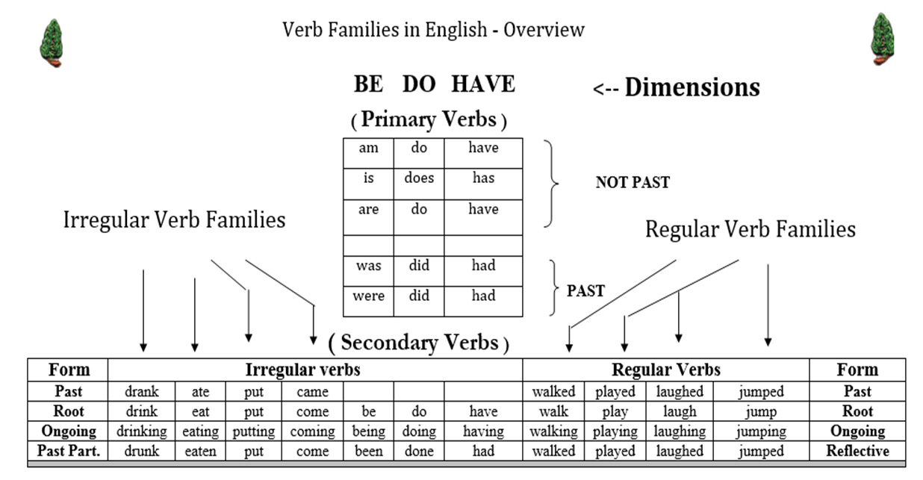
English Grammar: Behind the Screen
Notes:
The verb overview diagram needs to first be presented to students in simple form, adding detail as it is revisited. Here the two real ‘tenses’ are added: the “Past Tense” & “Not the Past” tenses.

Slide 19
English Grammar: Behind the Screen
How are BE, DO, & HAVE different from other verbs?
1) Only these three verb families have extra members
2) Only the primary members of these three verb families (plus the conditionals) form
negatives and questions (as well as positives)
3) BE sets the transformation pattern for this; DO & HAVE incorporate modifications
on this pattern so they are more easily distinguished from each other.
4) The 2^{ndary} verbs of BE (except the ‘Ongoing’ form) force the same rules as their
primary members on following 2^{ndary} verbs. `
Notes:
BE, DO, & HAVE share many characteristics which separate them from all the other verbs. They also have differences which help to individuate them from each other.

Slide 20

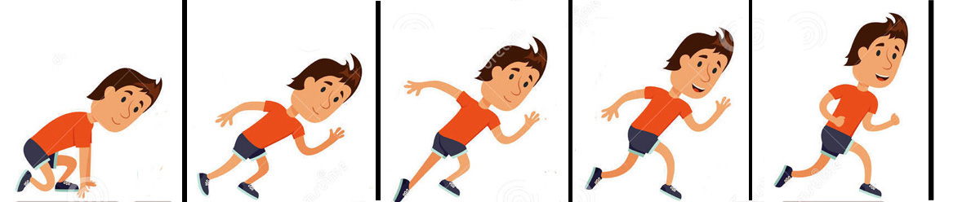

English Grammar: Behind the Screen
A sentence with a BE primary verb and no secondary verb indicates the following words will present a descriptive single frame ‘picture’ communication.
That is Bob.
Bob is a runner.
The man is happy.
Bob is on the race track.
A sentence with a BE primary verb and a secondary verb indicates the following words will present a communication involving a single series of contiguous ‘picture’ frames representing a single ‘event’.
Bob is running.
The man is racing happily.
Bob is running very fast.

Slide 21

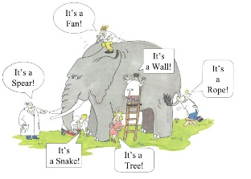

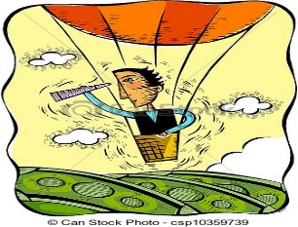
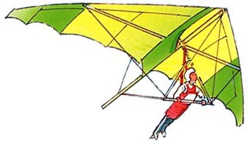
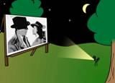

English Grammar: Behind the Screen
In sentences with a DO primary verb, the primary verb is elided or dropped in the positive case, but is retained in the negative and question cases.
If no BE verb is seen, the default understanding is that DO is the primary verb – unless the 2^{ndary} verb is a ‘HAVE’ primary verb, in which case the ‘reader/listener’ must check for a following 2^{ndary} verb in the P.P or Reflective form, which if found indicates that the sentence is in the HAVE dimension.
A sentence with a DO primary verb (elided or not) indicates the following words will present a communication involving a set of noncontiguous ‘picture’ frames with a common theme.
Bob drives a green sportscar.
Bob likes adventure.
Bob travels a lot.

Slide 22

English Grammar: Behind the Screen
In sentences with a HAVE primary verb, the primary verb must be followed by another 2^{ndary} verb in the past participle or ‘Reflective’ form.
A sentence with a HAVE primary verb indicates the following words will present a communication involving a relationship between two times or from one time to another.
The HAVE dimension allows us to incorporate information from a past time into a communication focused on a later time.
Have you been to Paris? Y/N
Where have you driven your car? WH?
How long have you been in Paris? Duration

Slide 23

English Grammar: Behind the Screen

Slide 24
English Grammar: Behind the Screen
I
You
He
She
It
Alex
The teacher
We
You
They
Ali and Art
The teachers
am
are
is
is
is
is
is
are
are
are
are
are
not
not
not
not
not
not
not
not
not
not
not
not
worked too hard.
studied by idiots.
stalked by Jack.
ridden often.
gone.
blown away.
tested by students.
stood up.
bought off.
wanted for hours.
bruised.
parked illegally.
Notes:
Note that not only does ‘ed’ signal the Past Tense (a reflection of ‘time’ back into the past) when the 2^{ndary} verb follows a DO primary verb], it also signifies a reflection in the application or direction of action of the verb when it follows a BE primary verb, even in all three cases: question negative & positive.

Slide 25
English Grammar: Behind the Screen
Ongoing and Reflective Suffixes in Adjectives
Also, consider the noun groups:
a wanted man the action is happening to the man
a dancing man the man is doing the action
a bored man the action is happening to the man
a boring man the man is doing the action
an interested man the action is happening to the man
an interesting man the man is doing the action
an excited man the action is happening to the man
an exciting man the man is doing the action
Notes:
Even further, ‘ed’ as an adjectival suffix has the same effect in that it reflects the direction of application of the adjective on its noun.

Slide 26
English Grammar: Behind the Screen
Reflective Form
Again we see that the ‘ed’ suffix causes a reversal of direction in the application of the action implied by the adjective form of the word.
This is a re-affirmation of its ‘Reflective’ characteristic.
One simple explanation instead of three or four different ones.
The ‘ed’ suffix is reflective in nature.
It causes a reversal or reflection:
1) to ‘Time’ in the DO Dimension;
2) to the ‘Direction of application of the Action’ in the BE Dimension; and
3) to the ‘Direction of Application’ as an adjective.
Notes:
So perhaps a better – more holistic name for this suffix – one which encompasses all of its functions – is “the Reflective.’ It causes a reflection of ‘Time’ after a DO primary verb (elided or not); It causes a reflection of the ‘direction of application of the verb’ when it follows a BE primary verb; and it causes this same type of reflection as an adjective – on its noun.

Slide 27
English Grammar: Behind the Screen
Scott Thornbury, editor for the Cambridge Handbooks for Language Teachers and author of over a dozen books on language learning has shown us 12 ways that ‘the ‘simple’ is used that do not match the definition. He asks, “Why are we still teaching the wrong grammar the wrong way?”
Are there 12 ‘tenses’ in English – or two?
Is this a sentence in the ‘present perfect’ – or in the HAVE dimension?
I have seen the pyramids of Giza in Egypt.
Notes:
Well – at least he has it mostly correct! Now if he would just abandon the “Simple Present Tense” paradigm – we might make some progress.

Slide 28
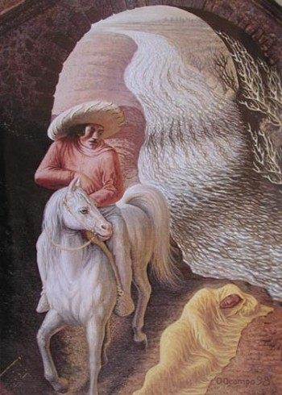
Notes:
I hope I have assisted you in seeing English grammar from a new perspective

Slide 29
English Grammar: Behind the Screen
by William Moore
Sept. 30, 2016
The End
(for now)
Teaching in Techno­colours: Imagine, Innovate, Inspire
2016 BC TEAL Interior Regional Conference

Slide 30
English Grammar: Behind the Screen
References
1.) I Love Translation. (2016). The Lunar Module. Retrieved from http://th4.ilovetranslation.com/TMvVbp8eS8u=d/
2.) https://en.wikipedia.org/wiki/Scott_Thornbury
Clipart from: https://www.dreamstime.com/illustration/storyboard.html

