Slide 1
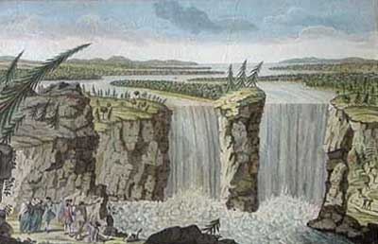



Canada: Celebrating 150 Years
Alternate Ways to Teach English

Slide 2
Alternate Ways to Teach English
PART 1
1) Using The Preposition Phrase to Teach English
PART 2
2) A Simple English Lesson: If the Simple Present Tense
does not exist – what does?
by William J. Moore

Slide 3
Alternate Ways to Teach English
Lee Gunderson & Catherine Eddy working with Immigration Canada, were responsible for E S L Testing & Placement in B.C. schools.
Advanced placement
in Canadian High Schools
is determined almost exclusively by the student’s ability
to use prepositions correctly.
At a TEAL Annual Conference in Vancouver, BC, in 1998 they informed their audience of the following:
They were testing on average 20,000 students per year (100/day),
so as to place them in the appropriate ESL classrooms.

Slide 4
Alternate Ways to Teach English
The preposition
is conventionally thought of as the first word
of a prepositional phrase.
Gorrell & Laird. Modern English Handbook. 1958
A prepositional phrase
consists of a preposition and its object, which is nearly always a noun group.
Collins Cobuild. English Grammar. 1992
as words that
‘express a relationship of meaning between two parts of a sentence.’
David Crystal. The Cambridge Encyclopedia of the English Language (1995)

Slide 5
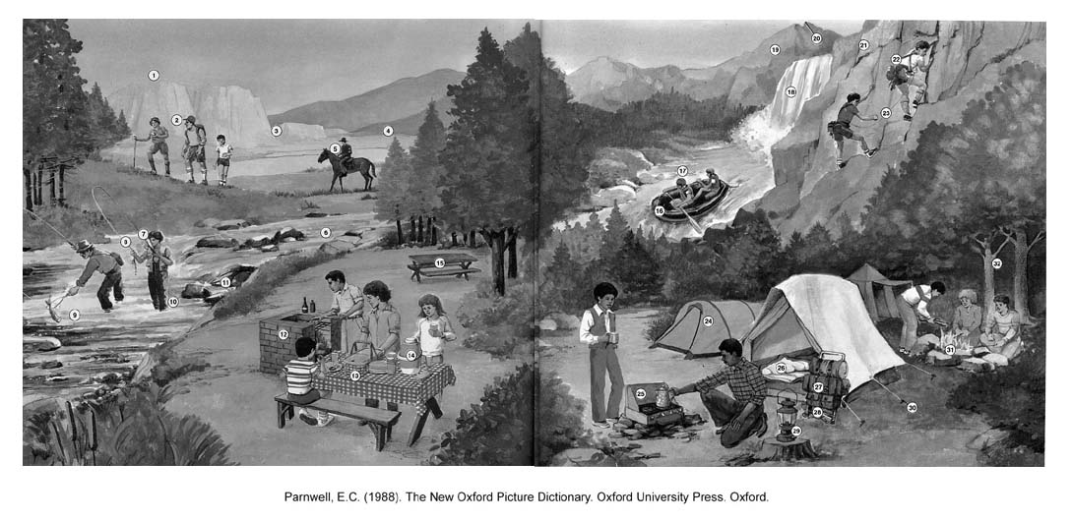
Alternate Ways to Teach English
“What can you see?” – “Use the word ‘on’.

Slide 6
Alternate Ways to Teach English
Preposition Preposition
word phrase
_________________________________________________________________________________________________
_on_______________ _________________a man on a horse_______________________________________________
__________________________________________________________________________________________________
_on_________________________________a lantern on a stump_____________________________________________
__________________________________________________________________________________________________
_on_________________________________a boy on a bench________________________________________________
__________________________________________________________________________________________________
__on________________________________a raft on the river_______________________________________________
_________________________________________________________________________________________________
Preposition Preposition Preposition
word function phrase
_on_______________ ___L_____________a man on a horse_____________________________________________ ___
___________________________________________________________________________________________________
_in__________________L_______________a lantern on a stump_____________________________________________
_________________________________________________________________________________________________
_on__________________L______________a boy on a bench________________________________________________
__________________________________________________________________________________________________
__on_________________L______________a raft on the river________________________________________________
__________________________________________________________________________________________________
tall
brown
storm

Slide 7
Alternate Ways to Teach English
“What are they doing?” – “Use a preposition.”

Slide 8
Alternate Ways to Teach English
Preposition Preposition Preposition Preposition Phrase
word function phrase Type
__________________________________________________________________________________________________
_on______________L _______________________ is riding on a horse_________________V - N___________________
__________________________________________________________________________________________________
_on______________L___________________________is on a stump__________________ V - N ___________________
__________________________________________________________________________________________________
_on______________L________________________is sitting on a bench________________ V - N ___________________
__________________________________________________________________________________________________
__on_____________L________________________is floating on the river______________ V - N ___________________
__________________________________________________________________________________________________
swiftly
quietly
roughly

Slide 9
Alternate Ways to Teach English
Preposition Preposition Preposition Preposition
word type phrase phrase type
______________________________young__________________________________
_in_______________L_________the ^{v} boys in the raft_______________N - N_____
______________________________________________________________________
_____________________________________________rough____________________
_down____________M________are ^{Λ} racing ^{Λ} down the ^{v} river_________V - N____
___________________________________quickly_____________________________
___________________________________white_______________________________
_across__________M______is ^{Λ} riding his ^{v} horse across the valley____VN - N__
___________________________happily_____________________________________
____________________________ __________________________________________
_into_____________M__________ ^{Λ} pouring coffee ^{Λ} into his cup________Vn - N___
__________________________ carefully_____________________________________

Slide 10
Alternate Ways to Teach English
50 Common Prepositions
about | at | during | off | to
above | before | for | on | toward
across | behind | from | onto | under
after | below | in | opposite | until
against | beneath | inside | out of | up
along | beside | into | in front of | through
alongside | between | like | over | with
among | beyond | near | past | within
around | by | next to | per | without
as | down | of | since | worth

Slide 11
Alternate Ways to Teach English
My friends go to school by car. I walk from my house across an open field behind my house and through an underpass everyday on my way to school. We all arrive at school at 7:00 am. We study for three hours with five minute breaks every hour. Then we have our lunch. We play football during this break after we finish eating our food. Then we study again for two more hours and finally school is finished. We can go home and play until 2:00 or 3:00 o’clock. I nap from 3:00 until 5:00 most days. Then I do my homework until dinner time. If I am finished my work, I can go out and play after dinner until 10:00 o’clock. I often go with my friends to the local football field. We play there until 9:00 o’clock and then go to our favourite tea shop for a chat and a cup of tea.
My friends go to school by car. I walk from my house across an open field behind my house and through an underpass everyday on my way to school. We all arrive at school at 7:00 am. We study for three hours with five minute breaks every hour. Then we have our lunch. We play football during this break after we finish eating our food. Then we study again for two more hours and finally school is finished. We can go home and play until 2:00 or 3:00 o’clock. I nap from 3:00 until 5:00 most days. Then I do my homework until dinner time. If I am finished my work, I can go out and play after dinner until 10:00 o’clock. I often go with my friends to the local football field. We play there until 9:00 o’clock and then go to our favourite tea shop for a chat and a cup of tea.

Slide 12
Alternate Ways to Teach English
My friends go to school by car. I walk from my house across an open field behind my house and through an underpass everyday on my way to school. We all arrive at school at 7:00 am. We study for three hours with five minute breaks every hour. Then we have our lunch. We play football during this break after we finish eating our food. Then we study again for two more hours and finally school is finished. We can go home and play until 2:00 or 3:00 o’clock. I nap from 3:00 until 5:00 most days. Then I do my homework until dinner time. If I am finished my work, I can go out and play after dinner until 10:00 o’clock. I often go with my friends to the local football field. We play there until 9:00 o’clock and then go to our favourite tea shop for a chat and a cup of tea.

Slide 13
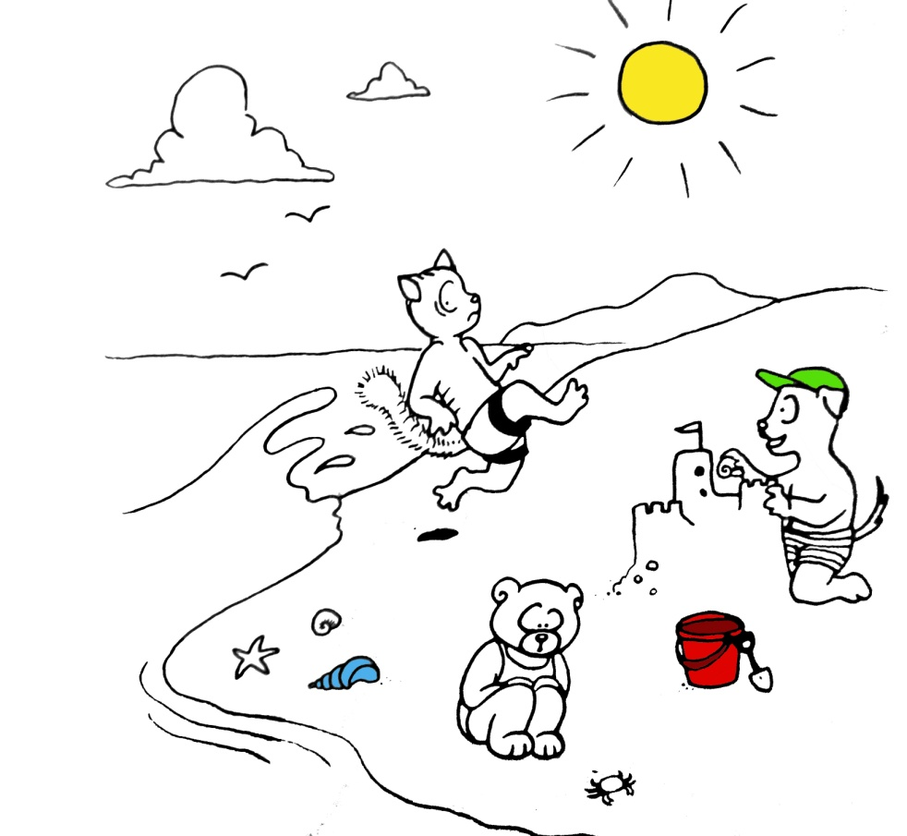
Alternate Ways to Teach English
A Day at the Beach
Three children from Nanaimo are playing at the beach today. Fred, the boy in the green hat, is building a castle out of sand – a sandcastle. Joe is playing in the waves. Right now he is running away from a wave. Jenny is watching a crab crawl up the beach. The children come to the beach every summer. They play by the water every day. Their mom even brings lunch to them so they don’t have to stop playing. Now that’s the life for me!
Jenny is watching a crab crawl up the beach.
Jenny is watching as a crab crawls up the beach.
Jenny is watching a crab as it crawls up the beach.

Slide 14
Alternate Ways to Teach English
He was in the umbrella department, on the first floor, opening and closing the umbrellas and throwing them on the floor. He seemed to be getting very angry.
went shopping in Macy’s
A gorilla went shopping in Macy’s one day.
was in the umbrella department,
was
was
the umbrella department,
was in the umbrella department,
on the first floor,
A gorilla went shopping in Macy’s one day. He was in the umbrella department, on the first floor, opening and closing the umbrellas and throwing them on the floor. He seemed to be getting very angry.
A customer was watching all this and finally ran up to a clerk and said, “Excuse me, but there’s an angry gorilla over there playing with the umbrellas.”
“I’m sorry,” said the clerk, “but that’s not my department. Try the third floor.” So the customer ran to the third floor, found the manager, told him the story, and they both rushed back to the gorilla. The manager was trembling, but he tried to smile and walked right up to the big beast, saying, “Pardon me, Sir or Madam, but, well, you know we’ve never seen a gorilla in Macy’s before.”
“I’m not surprised,” said the gorilla, “and with these prices you’re not going to see many more either.”
A gorilla went shopping in Macy’s one day. He was in the umbrella department, on the first floor, opening and closing the umbrellas and throwing them on the floor. He seemed to be getting very angry.
A customer was watching all this and finally ran up to a clerk and said, “Excuse me, but there’s an angry gorilla over there playing with the umbrellas.”
“I’m sorry,” said the clerk, “but that’s not my department. Try the third floor.” So the customer ran to the third floor, found the manager, told him the story, and they both rushed back to the gorilla. The manager was trembling, but he tried to smile and walked right up to the big beast, saying, “Pardon me, Sir or Madam, but, well, you know we’ve never seen a gorilla in Macy’s before.”
“I’m not surprised,” said the gorilla, “and with these prices you’re not going to see many more either.”
on the first floor,
throwing them on the
on the first floor,
floor.
From: Graham, C1982) The Electric Elephant. Oxford U. Press
Notes:
What this means is that while writing is linear, thinking is not. We are capable of juggling the bits of information in a sentence and connecting them in non-linear ways. In order to teach our students these ‘ways’ we need to have them work with the parts that are juggled. The parts that are juggled are currently called ‘preposition phrases, but these are just half of the picture. We need to include the verb Group in this study so students can learn about transitive, intransitive and ergative usages.

Slide 15
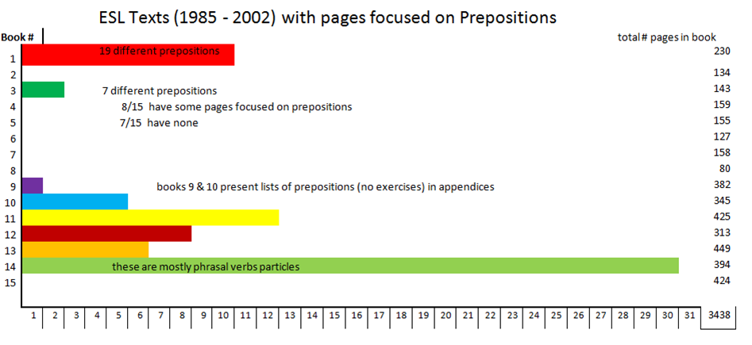
Alternate Ways to Teach English
Pages focused on prepositions
74 / 3438 = 2%

Slide 16
Preposterous Prepositions! Practice with English
Bluenose put in a full fishing season in the spring and summer of 1921. This was a condition for entrance into the International Fisherman's Race against the Americans - which was the real reason for building the Bluenose. Captain Angus Walters had been fishing ever since he was 13 years old. He learned how to sail on his father's fishing schooner. When he became captain of the Bluenose, people said he was a difficult man to get along with, but he was very intelligent and knew how to handle his ship. He could bring her through any kind of water or poor weather conditions. 12 preps
Bluenose put in a full fishing season in the spring and summer of 1921. This was a condition for entrance into the International Fisherman's Race against the Americans - which was the real reason for building the Bluenose. Captain Angus Walters had been fishing ever since he was 13 years old. He learned how to sail on his father's fishing schooner. When he became captain of the Bluenose, people said he was a difficult man to get along with, but he was very intelligent and knew how to handle his ship. He could bring her through any kind of water or poor weather conditions. 14 verbs

Slide 17
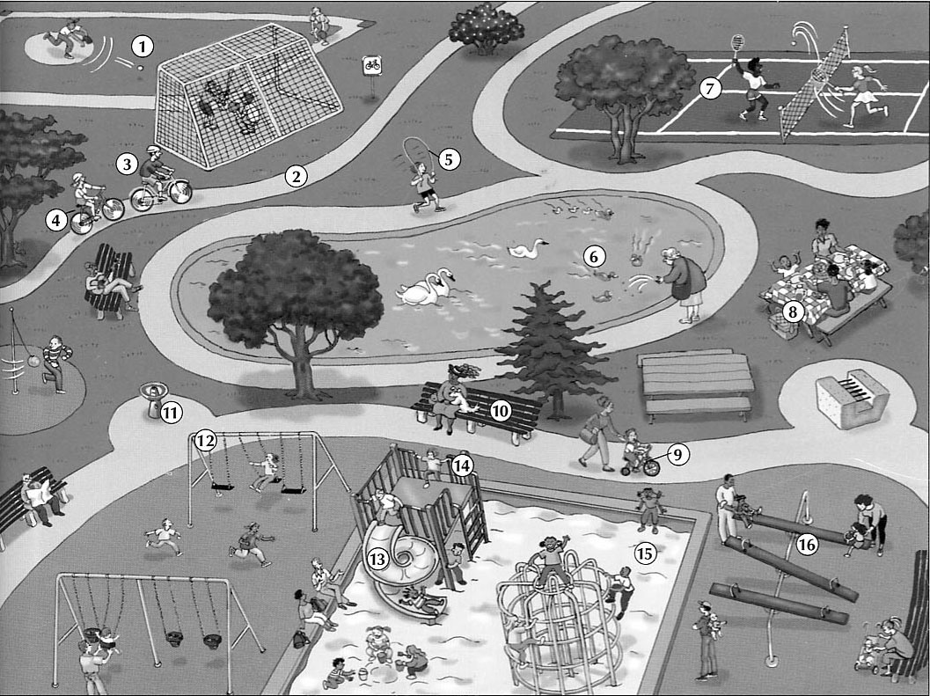
Alternate Ways to Teach English
Notes:
Look at this picture – find it in your handouts – pair up – one of you describe the picture with special attention to location relative to other objects in the picture, the other records the prepositions used – set a timer for 2 minutes.

Slide 18
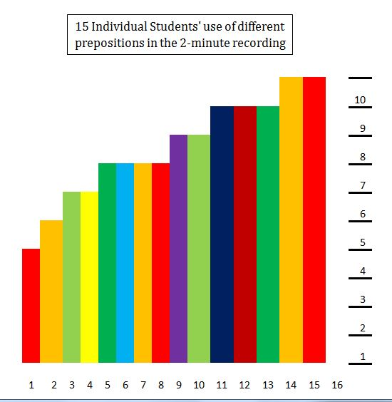
Alternate Ways to Teach English

Slide 19
Alternate Ways to Teach English
2) A Simple English Lesson: If the Simple Present Tense
does not exist – what does?
English has 3 Dimensions: BE, DO & HAVE

Slide 20
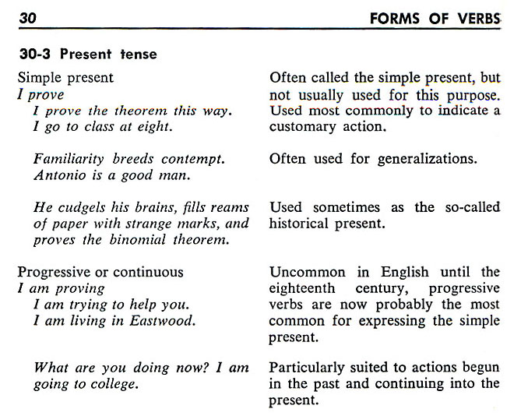
Alternate Ways to Teach English
Gorrell, R. & Laird, C. (1956). Modertn English Handbook. 2nd ed. Prentice-Hall. Englewood Cliffs, NJ. p. 358
Notes:
Behind the screen.
If the simple present tense is not often used for this purpose, and the present progressive is usually used to express [what used to be expressed by] the simple present, why are we still referring to that verb form by that name? A ‘shell’ company serves the same purpose – to hide the truth.

Slide 21
Alternate Ways to Teach English
300 odd years ago
250 not so odd years ago
I cook steak now.
I am cooking steak now.
The Simple Present Tense
The Present Progressive Tense

Slide 22
Alternate Ways to Teach English
SUBJECTS : Proper Nouns, Common Nouns, & Pronouns
Singular
English
Arabic
3rd Person
1st
Person
I
You
He
She
It
Alfred
The teacher
We
You
They
Art and Alfred
The teachers
هو
هي
هم
هن
أنت
أنتي
أنتم
أنتن
أنا
نحنِ
he
she
they
they
you
you
you
you
I
we
Singular
(masc)
2nd
(fem)
Plural
(masc)
(fem)
3rd
2nd Person
Singular
(masc)
Plural
(fem)
Plural
1st
Person
(masc)
2nd
(fem)
1st Person
Singular
3rd
Plural
Notes:
By convention, English Subjects are organized this way – by simple agreement – Arabic Subjects – by way of contrast are organized quite differently. By studying Arabic grammar (slightly) I was able to look at English with fresh eyes

Slide 23
Alternate Ways to Teach English
do
do
does
does
does
does
does
do
do
do
do
do
I
You
He
She
It
Ahmed
The teacher
We
You
They
Ali and Ahmed
The teachers
do
do
does
does
does
does
does
do
do
do
do
do
do
do
does
does
does
does
does
do
do
do
do
do
not
not
not
not
not
not
not
not
not
not
not
not
work
study
talk
ride
go
fly
teach
sit
buy
want
have
mark
work
study
talks
rides
goes
flies
teaches
sit
buy
want
have
mark
We elide the DO primary verb in the positive, but suffix the ‘s’ or ‘es’ onto the 2^{ndary} verb in the 3rd person singular.
s
s
es
es
es
We retain the DO primary verb in the negative.
Notes:
Why do verbs in the 3rd person singular have an ‘s’ or ‘es’ added to them? This is why. We elide the primary DO verb in the positive because it is unnecessary to the communication, but we retain it in the negative and question.

Slide 24
Alternate Ways to Teach English
Do
Do
Does
Does
Does
Does
Does
Do
Do
Do
Do
Do
I
You
He
She
It
Ahmed
The teacher
We
You
They
Ali and Ahmed
The teachers
I
you
he
she
it
Ahmed
the teacher
we
you
they
Ali and Ahmed
the teachers
do
do
does
does
does
does
does
do
do
do
do
do
work
study
talk
ride
go
fly
teach
sit
buy
want
have
mark
?
?
?
?
?
?
?
?
?
?
?
?
We also retain the DO primary verb in the question form.

Slide 25
Alternate Ways to Teach English
I
You
He
She
It
Ahmed
The teacher
We
You
They
Ali and Ahmed
The teachers
did
did
did
did
did
did
did
did
did
did
did
did
id
id
id
id
id
not
not
not
not
not
not
not
not
not
not
not
not
work.
study.
talk.
ride.
go.
fly.
teach.
sit.
buy.
want.
have.
mark.
worked.
studied.
talked.
rode.
went.
flew.
taught.
sat.
bought.
wanted.
had.
marked.
Notes:
Here is a second example of eliding the DO primary verb and suffixing a part of it (the last sound) onto the following verb.

Slide 26
Alternate Ways to Teach English
The lunar module was on the Moon. Astronaut Neil Armstrong had come out of the door and looked up into black space. He looked down at the gray rocks. The Moon waited. Slowly, he moved down the stairs. When he got to the bottom, he stopped. Then, he carefully put his foot down on the ground. He was the first man on the Moon.
Three hundred and twenty thousand kilometers away on Earth, people watched Neil Armstrong on television. They laughed and shouted. A man was on the Moon!
Jim Lovell sat in front of his television with his wife and children. "I'm not the first man on the Moon," Jim said to his son Jeffrey. "But I will go there."
Jeffrey was only five years old and he was excited. "Look at the rocks, Dad!" he shouted. "Look at the moon rocks!"
The lunar module was on the Moon. Astronaut Neil Armstrong had come out of the door and looked up into black space. He looked down at the gray rocks. The Moon waited. Slowly, he moved down the stairs. When he got to the bottom, he stopped. Then, he carefully put his foot down on the ground. He was the first man on the Moon.
Three hundred and twenty thousand kilometers away on Earth, people watched Neil Armstrong on television. They laughed and shouted. A man was on the Moon!
Jim Lovell sat in front of his television with his wife and children. "I'm not the first man on the Moon," Jim said to his son Jeffrey. "But I will go there."
Jeffrey was only five years old and he was excited. "Look at the rocks, Dad!" he shouted. "Look at the moon rocks!“¹
Notes:
If you really look at texts, with the knowledge that the DO primary verb is elided in the positive, you will see that every sentence in English falls within one of these 3 Dimensions of communication.

Slide 27

Alternate Ways to Teach English
BE
DO
HAVE
“All simple English sentences”
The ‘Verb Families’, BE, DO & HAVE mark Dimensions of communications
Notes:
These primary verbs actually predict the type of communication coming: single snapshot, a contiguous strip about a single ‘event’, a non-contiguous series of snapshots with common themes, or having reference to the relationship between two ‘times’, either as single points or referring to the duration between them.

Slide 28
Alternate Ways to Teach English
BE
DO
HAVE
BE
DO
HAVE
Real / Direct
Unreal / Conditional
Conditionals can only exist based on Real situations

Slide 29
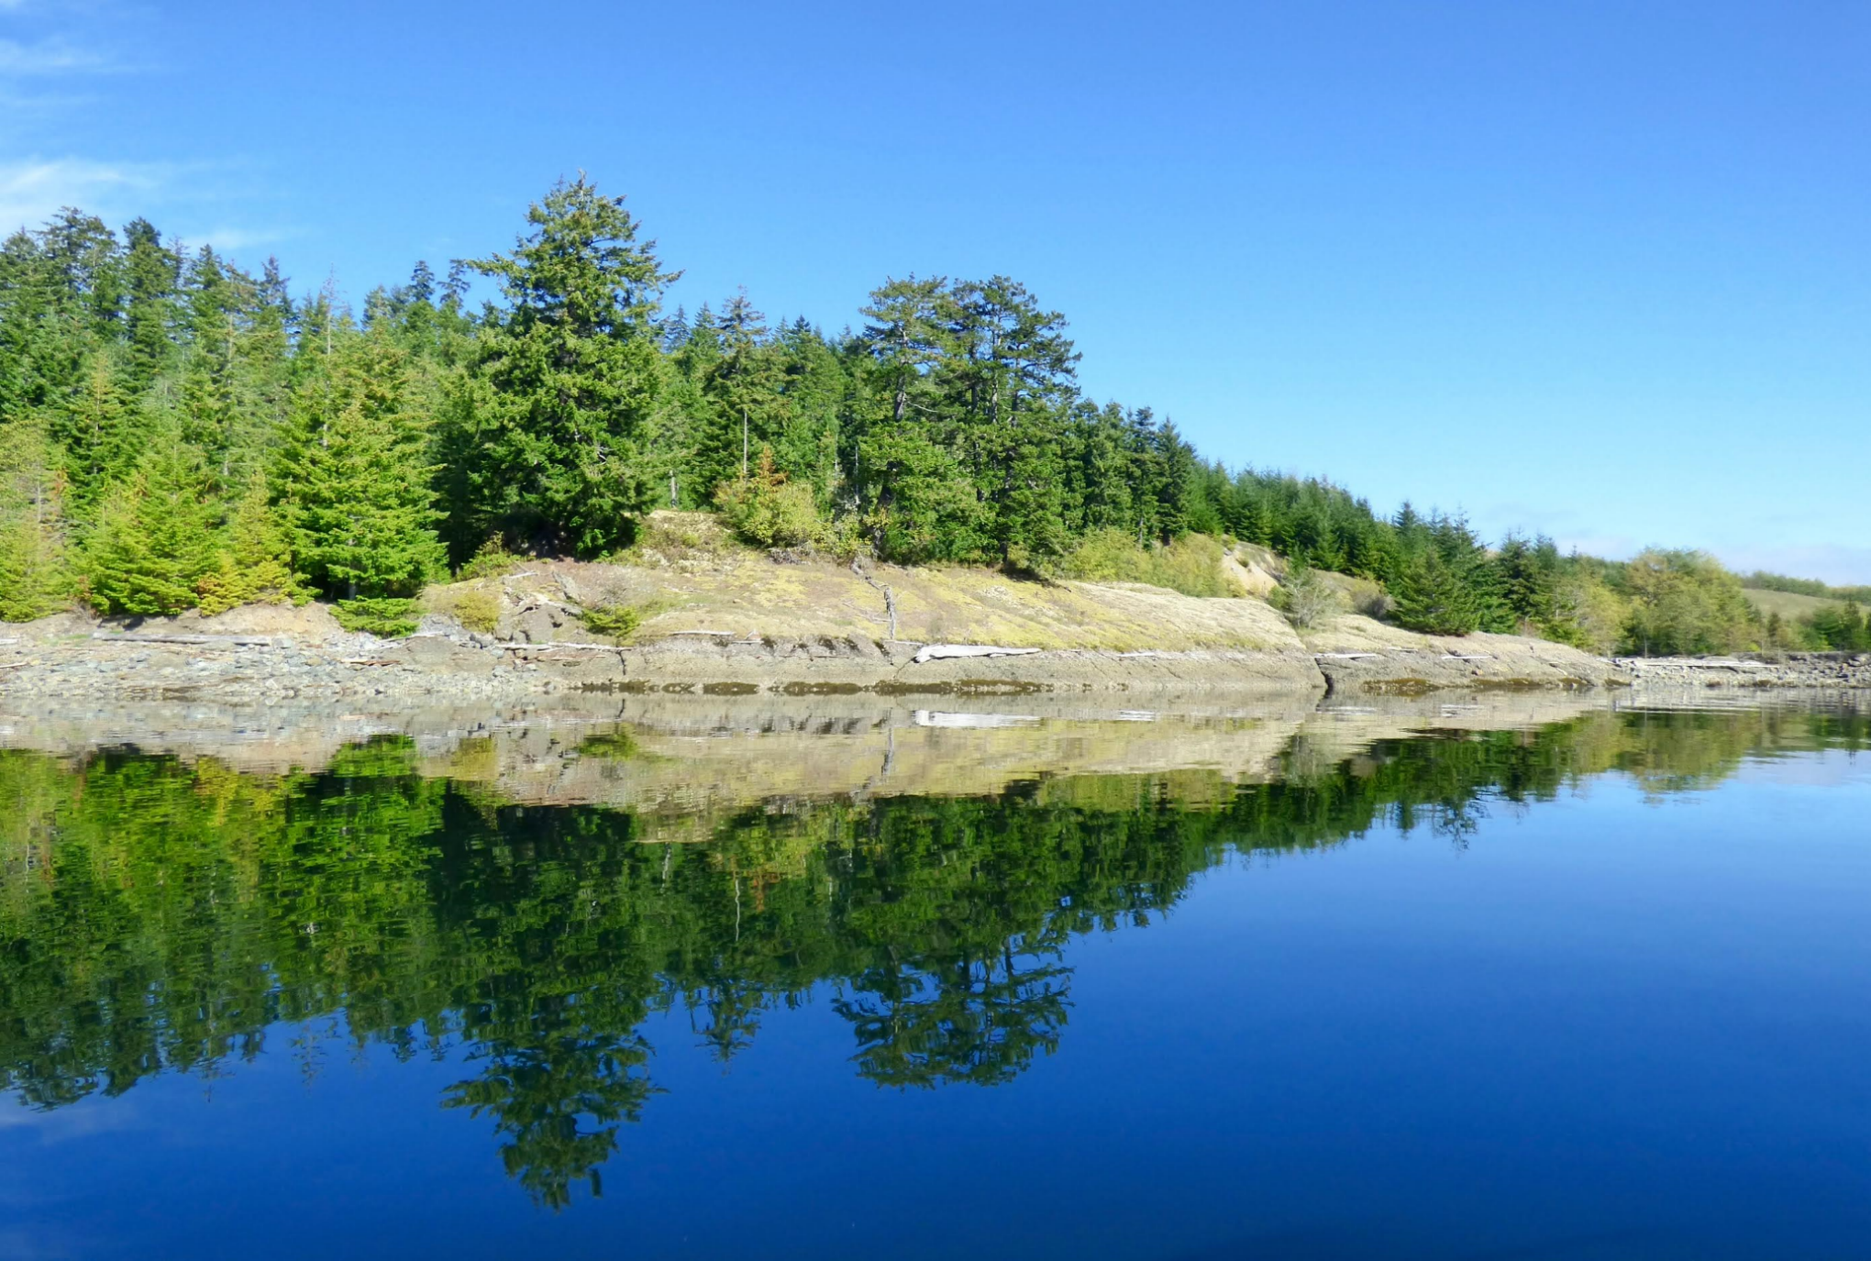
Alternate Ways to Teach English
Real / Direct
Conditional
Notes:
‘Conditionals’ are to a ‘reflection’ as BE, DO, & HAVE are to the real world.

Slide 30
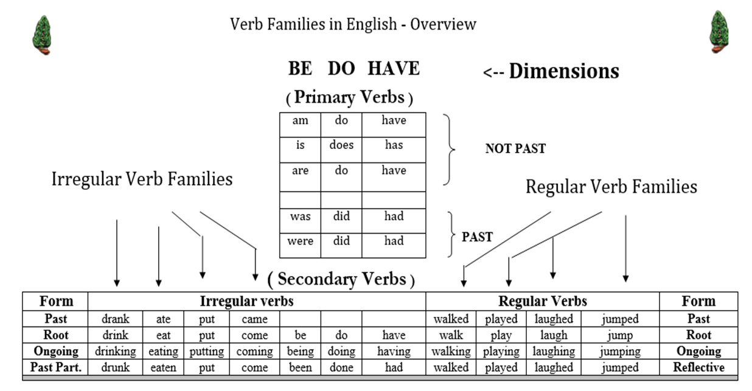
Alternate Ways to Teach English
Notes:
The verb overview diagram needs to first be presented to students in simple form, adding detail as it is revisited. Here the two real ‘tenses’ are added: the “Past Tense” & “Not the Past” tenses.

Slide 31
Alternate Ways to Teach English
How are BE, DO, & HAVE different from other verbs?
Only these three verb families have extra members
Only the primary verbs carry the tense
3) Only the primary verbs (and conditionals) form positives, negatives and questions
4) BE sets the transformation pattern; DO & HAVE incorporate modifications
on this pattern so they are more easily distinguished from each other.
5) The 2^{ndary} verbs of BE (except the ‘Ongoing’ form) force the same rules as their
primary members on following 2^{ndary} verbs.
Notes:
BE, DO, & HAVE share many characteristics which separate them from all the other verbs. They also have differences which help to individuate them from each other.

Slide 32

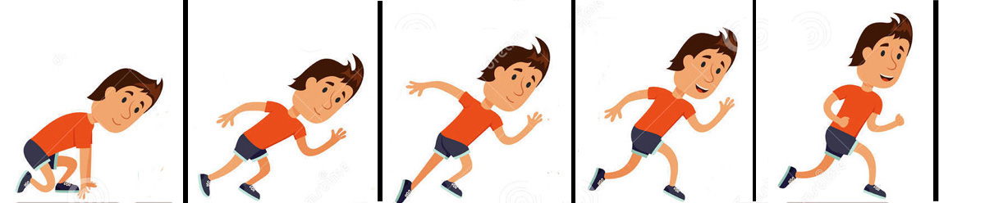

Alternate Ways to Teach English
A sentence with a BE primary verb and no secondary verb indicates the following words will present a descriptive single frame ‘picture’ communication.
That is Bob.
Bob is a runner.
The man is happy.
Bob is on the race track.
A sentence with a BE primary verb and a secondary verb indicates the following words will present a communication involving a single series of contiguous ‘picture’ frames representing a single ‘event’.
Bob is running.
The man is racing happily.
Bob is running very fast.

Slide 33

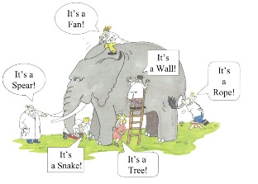

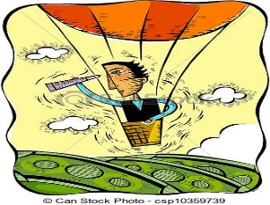
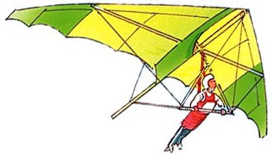


Alternate Ways to Teach English
In sentences with a DO primary verb, the primary verb is elided or dropped in the positive case, but is retained in the negative and question cases.
If no BE verb is seen, the default understanding is that DO is the primary verb – unless the verb is ‘have’ or ‘had’, in which case the ‘reader/listener’ must check for a following 2^{ndary} verb in the P.P or Reflective form, which if found, indicates that the sentence is in the HAVE dimension.
A sentence with a DO primary verb (elided or not) indicates the following words will present a communication involving the need to figure out the time reference intuitively.
I see the Eiffel tower. = now
He drives a car. = anytime
Bob watches tv sports. = anytime

Slide 34

Alternate Ways to Teach English
In sentences with a HAVE primary verb, the primary verb must be followed by another 2^{ndary} verb in the past participle or ‘Reflective’ form.
A sentence with a HAVE primary verb indicates the following words will present a communication involving a relationship between two times or from one time to another.
The HAVE dimension allows us to incorporate information from a past time into a communication focused on a later time.
Have you been to Paris? Y/N
Where have you driven your car? WH?
How long have you been in Paris? Duration

Slide 35
Alternate Ways to Teach English
I
You
He
She
It
Alex
The teacher
We
You
They
Ali and Art
The teachers
am
are
is
is
is
is
is
are
are
are
are
are
not
not
not
not
not
not
not
not
not
not
not
not
worked too hard.
studied by idiots.
stalked by Jack.
ridden often.
gone.
blown away.
tested by students.
stood up.
bought off.
wanted for hours.
bruised.
parked illegally.
Notes:
Note that not only does ‘ed’ signal the Past Tense (a reflection of ‘time’ back into the past) when the 2^{ndary} verb follows a DO primary verb], it also signifies a reflection in the application or direction of action of the verb when it follows a BE primary verb, even in all three cases: question negative & positive.

Slide 36
Ongoing and Reflective Suffixes in Adjectives
Also, consider the noun groups:
a wanted man the action is happening to the man
a dancing man the man is doing the action
a bored man the action is happening to the man
a boring man the man is doing the action
an interested man the action is happening to the man
an interesting man the man is doing the action
an excited man the action is happening to the man
an exciting man the man is doing the action
Notes:
Even further, ‘ed’ as an adjectival suffix has the same effect in that it reflects the direction of application of the adjective on its noun.

Slide 37
Alternate Ways to Teach English
Reflective Form
Again we see that the ‘ed’ suffix causes a reversal of direction in the application of the action implied by the adjective form of the word.
This is a re-affirmation of its ‘Reflective’ characteristic.
One simple explanation instead of three or four different ones.
The ‘ed’ suffix is reflective in nature.
It causes a reversal or reflection:
1) to ‘Time’ in the DO Dimension;
2) to the ‘Direction of application of the Action’ in the BE Dimension; and
3) to the ‘Direction of Application’ as an adjective.
Notes:
So perhaps a better – more holistic name for this suffix – one which encompasses all of its functions – is “the Reflective.’ It causes a reflection of ‘Time’ after a DO primary verb (elided or not); It causes a reflection of the ‘direction of application of the verb’ when it follows a BE primary verb; and it causes this same type of reflection as an adjective – on its noun.

Slide 38
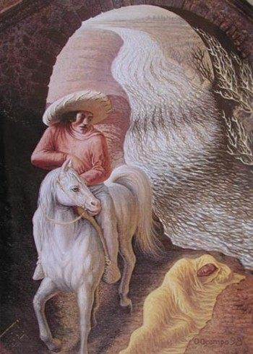
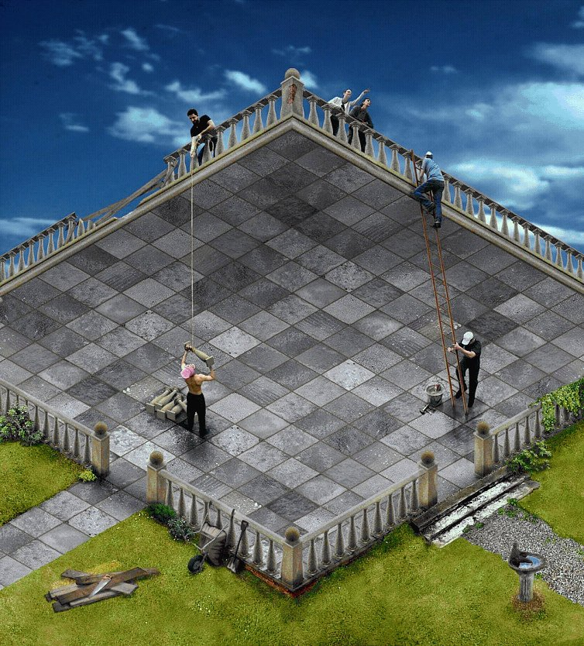
Notes:
I hope I have assisted you in seeing English grammar from a new perspective

Slide 39
Canada: Celebrating 150 Years
Alternate Ways to Teach English
The End
Thank you for your kind attention
www.asel.ca

